Slide 1


Enhancement of the ESMValTool to support
CMIP6 Simulations (AP6)
Björn Brötz¹, Lisa Bock¹, Veronika Eyring^{1,2}, Axel Lauer¹, Mattia Righi¹, Manuel Schlund¹, and Birgit Hassler¹
¹Deutsches Zentrum für Luft- und Raumfahrt (DLR), Institut für Physik der Atmosphäre, Oberpfaffenhofen, Germany
²University of Bremen, Institute of Environmental Physics (IUP), Bremen, Germany
CMIP6-DICAD Final Meeting
22 June 2020

Slide 2
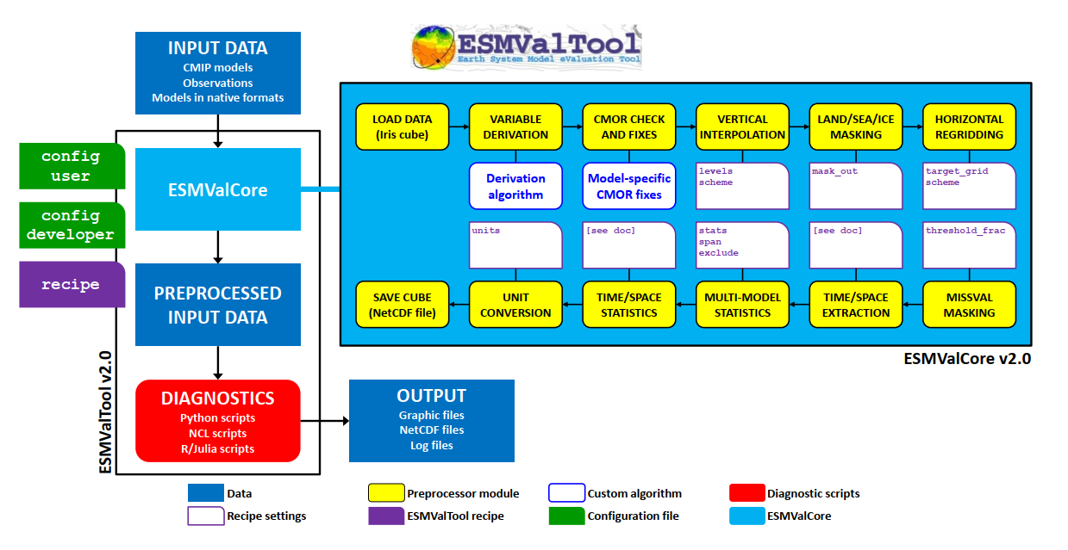
Notes:
<Foliennummer>

Slide 3
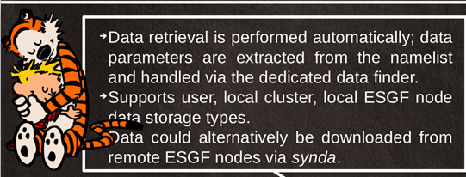
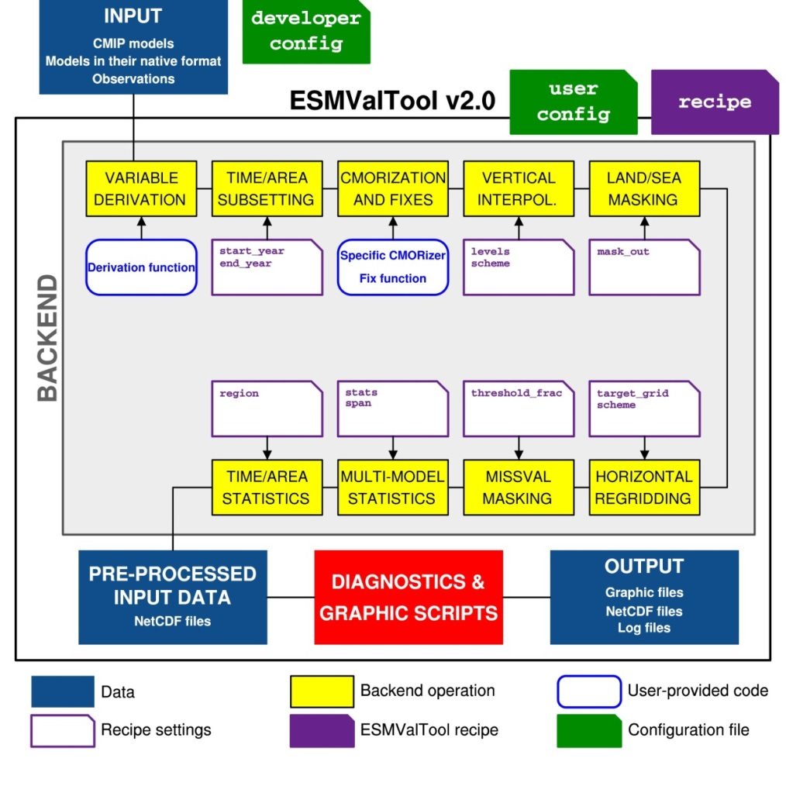

www.DLR.de • Folie <Foliennummer>
Enhancements of ESMValTool (v2)
ESMValTool preprocessor now fully based on python with Conda installation
technical separation of core and diagnostic part
Frequent releases / 8 in 2019 (2 ESMValTool / 6 ESMValCore)
Modern standards for storing configuration files (YAML), data (NetCDF), and provenance information (W3C PROV)
Revised Backend for a central preprocessing of input data (9 operations)
New interface between workflow and diagnostics
Huge gain in execution time: factor 10 to 20 (depending on recipe)
Professional software development tools, e.g.
  code review (through GibHub pull requests)
  automated testing (using CircleCI)
  software quality monitoring (static code analysis through Codacy and a consistent coding style enforced through unit tests)
=> ensures that the ESMValTool is reliable, well documented and easy to maintain.
Notes:
<Foliennummer>

Slide 4
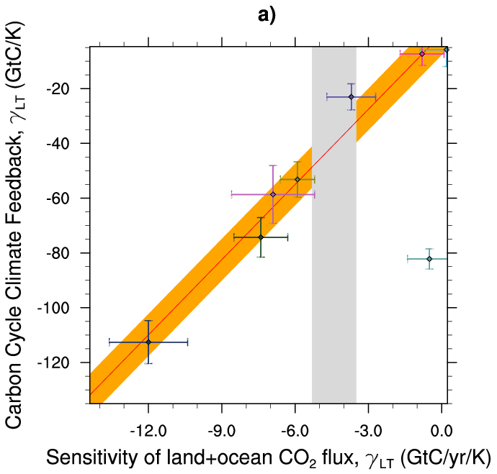
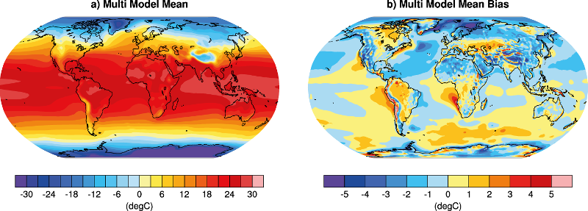
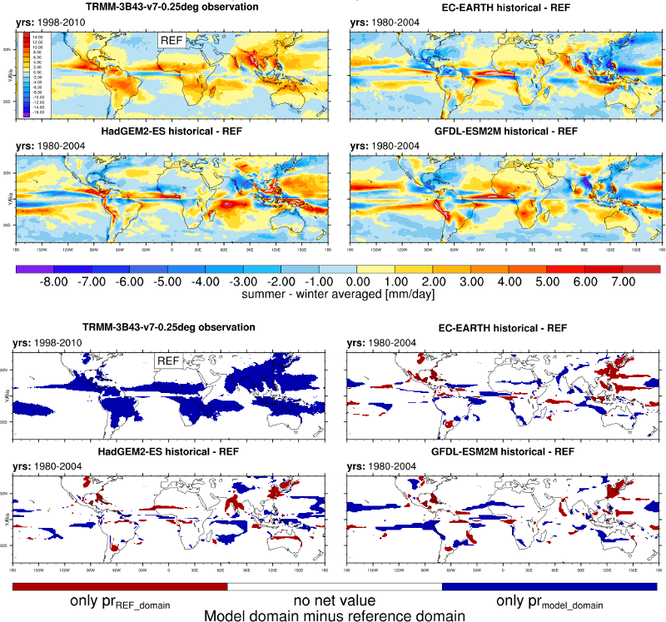
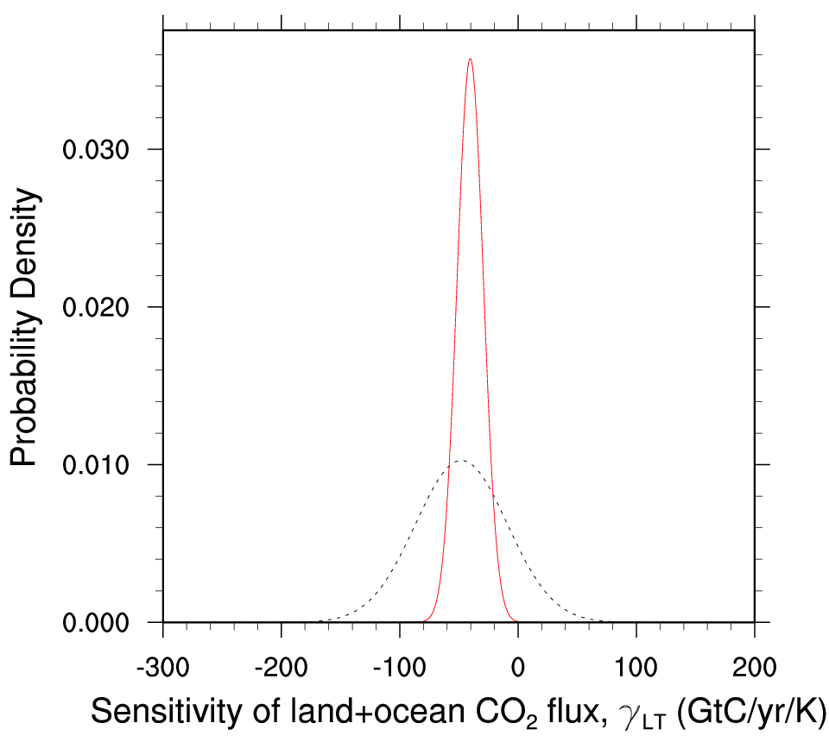
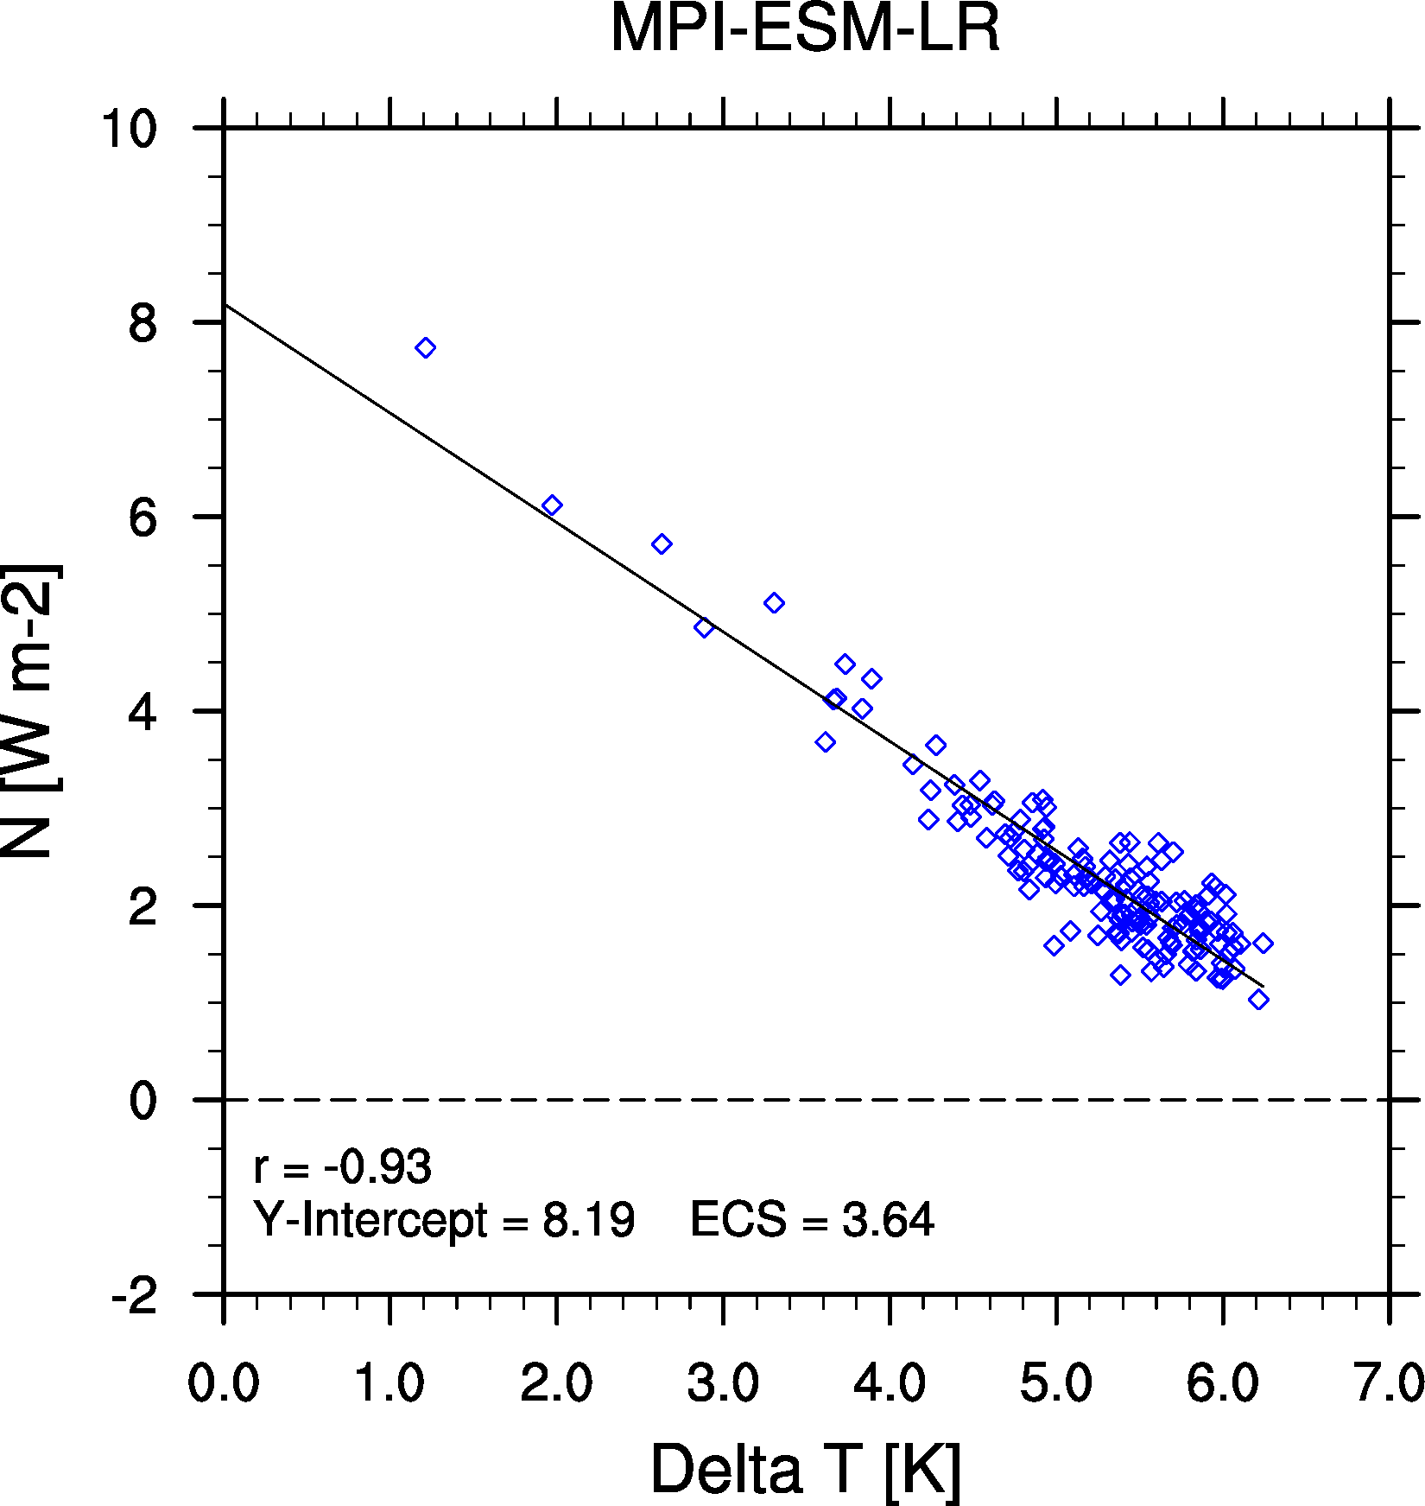
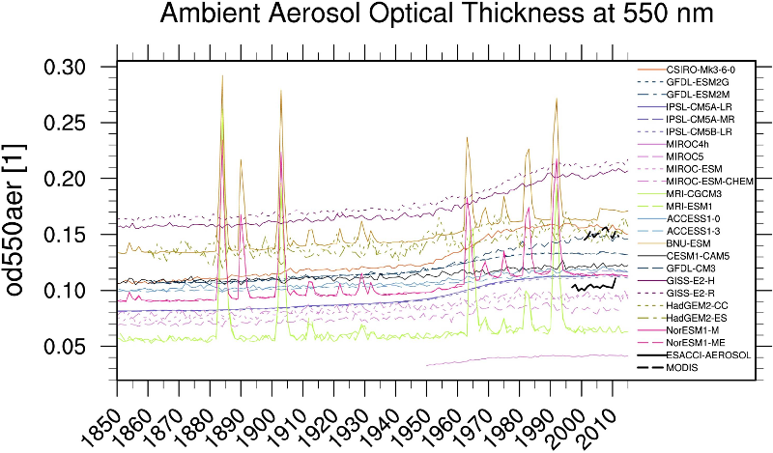
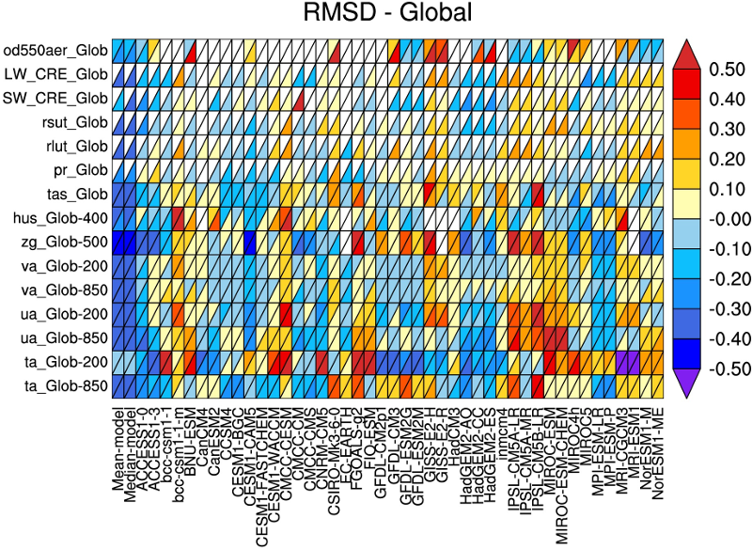
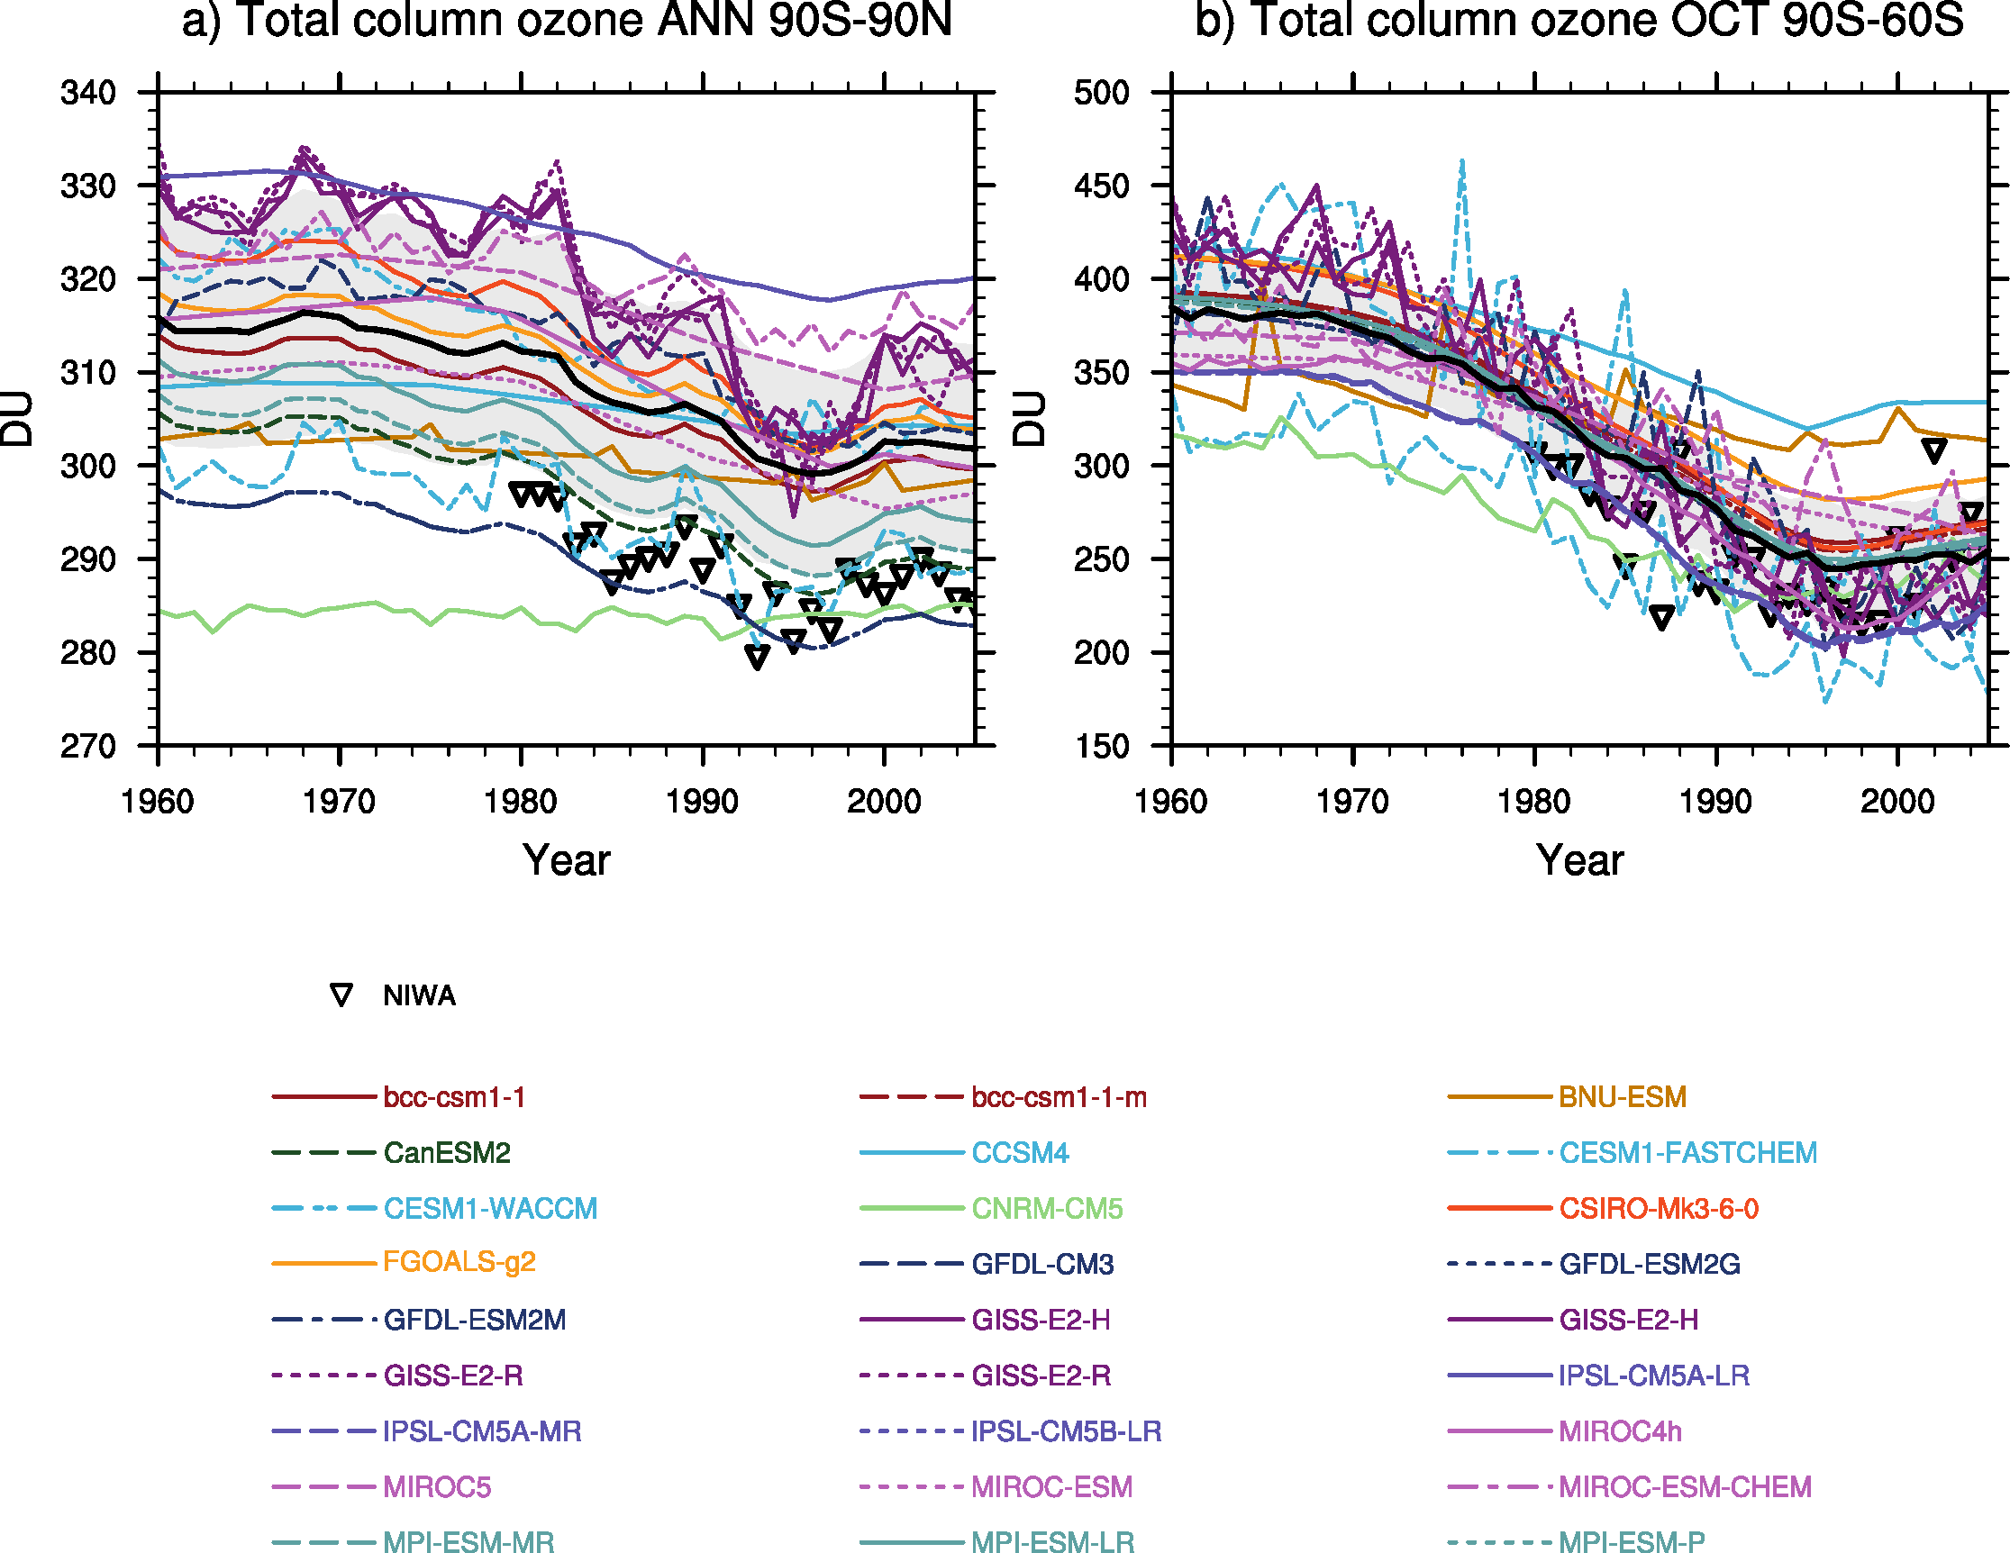
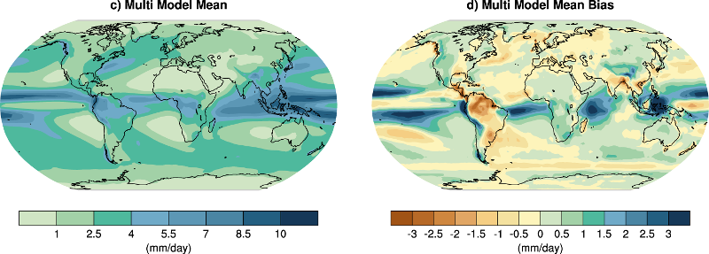
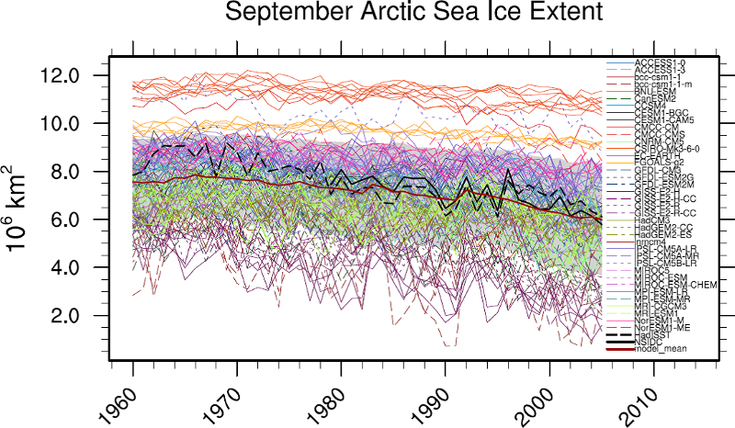

Enhanced diagnostics ESMValTool (v2)
Growing number of recipes included

Slide 5
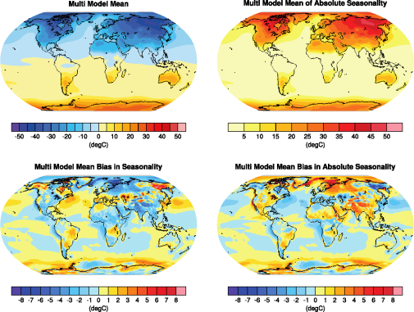
Provenance in the ESMValTool
traceability and reproducibility
Provenance information
Creation date
Host and user
Version number of the ESMValTool
List of recipes / diagnostics run
Variables and models processed
List of all model files that have been used including + Tracking ID (read from metadata if available)
Patches applied to model data (if any)
List of all observations used including references
Contributing authors and acknowledgment of projects
Tagging: meta data attached to NetCDF and image files
recipe
diagnostic
ESMValTool + Python version
input files (tracking id)
models + observations
figure caption
CMIP6 realm
variables
projects
theme
domain
contributing authors
plot type
statistics + metrics
references
Notes:
<Foliennummer>

Slide 6

Provenance in the ESMValTool
traceability and reproducibility
document and organize the results, while keeping track of all the input data used to produce them
using the W3C-PROV standard (compatible with other (external) tools for viewing and processing provenance information). https://www.w3.org/TR/prov-overview/
collected at run-time and attached to any output (plots and netCDF files) produced by the tool (also saved to a separate log file)
Provenance information is saved as:
  svg-file
  xml-file
  attribute of the netCDF-file
  exif-header to png file

Slide 7
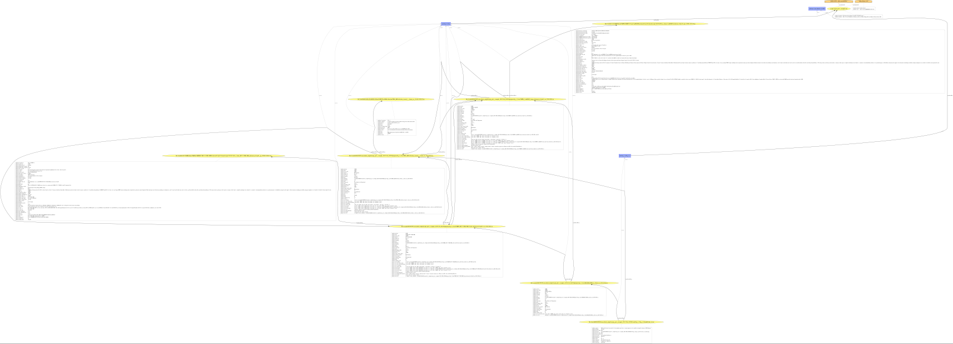
Provenance in the ESMValTool
svg-file:

Slide 8
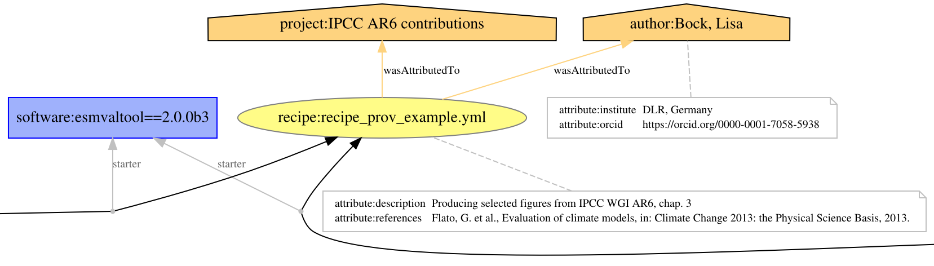
Provenance in the ESMValTool
svg-file:
general
information

Slide 9
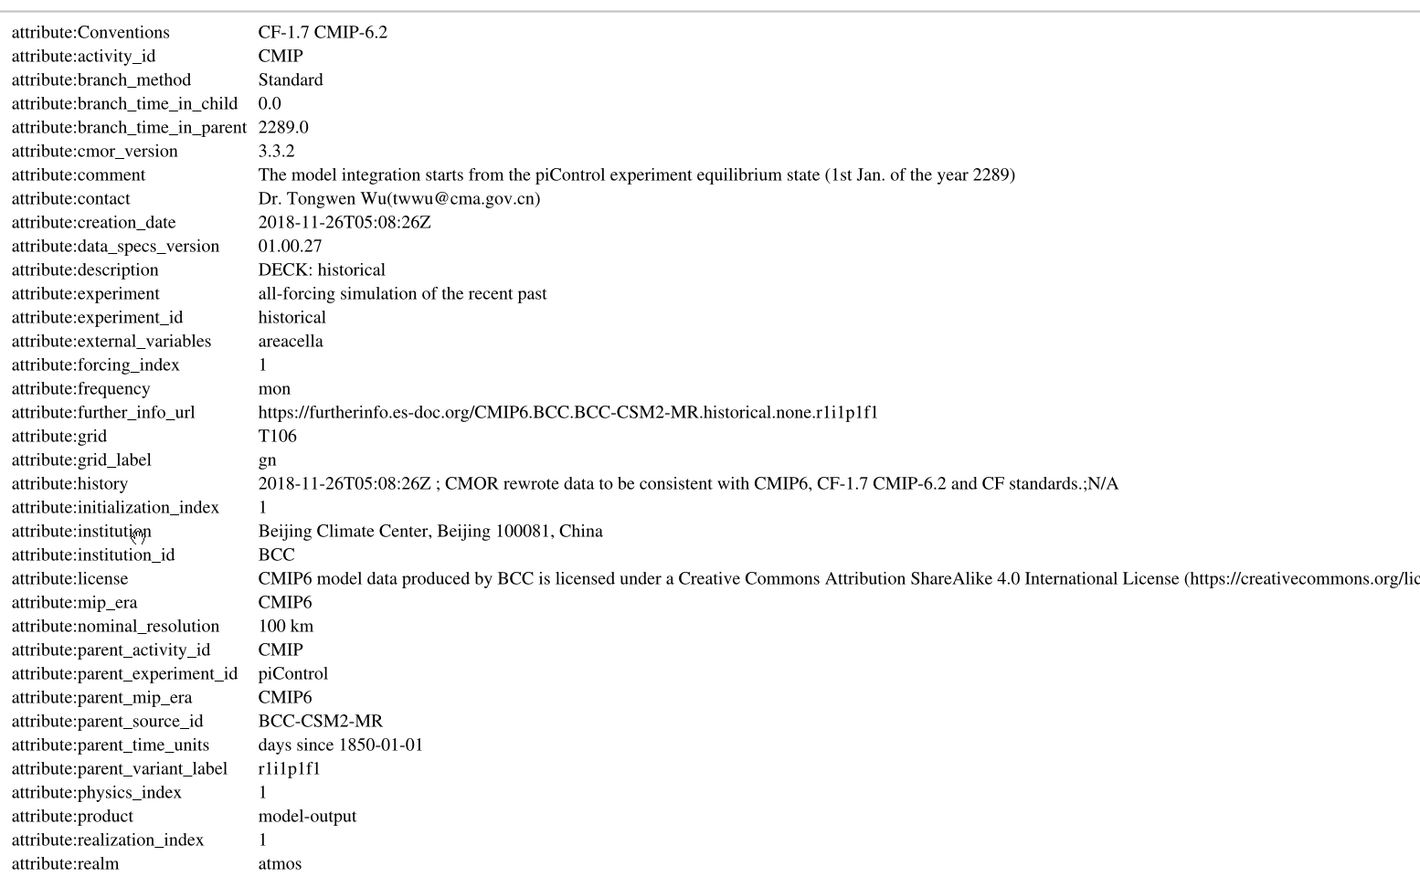
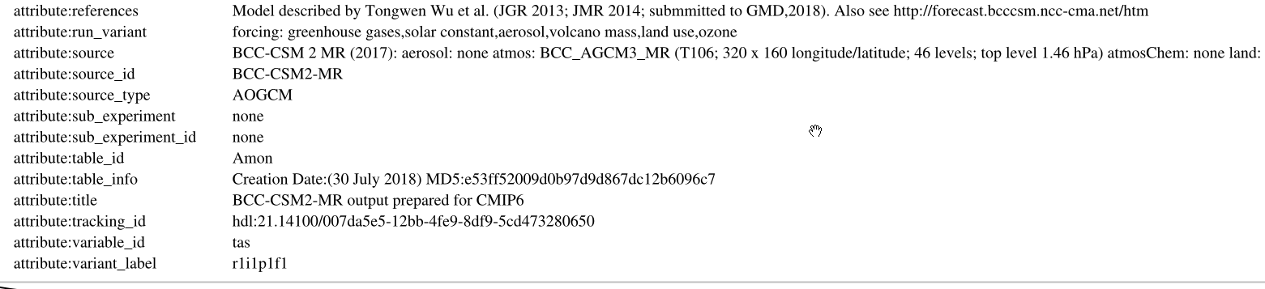
Provenance in the ESMValTool
svg-file:
input dataset

Slide 10
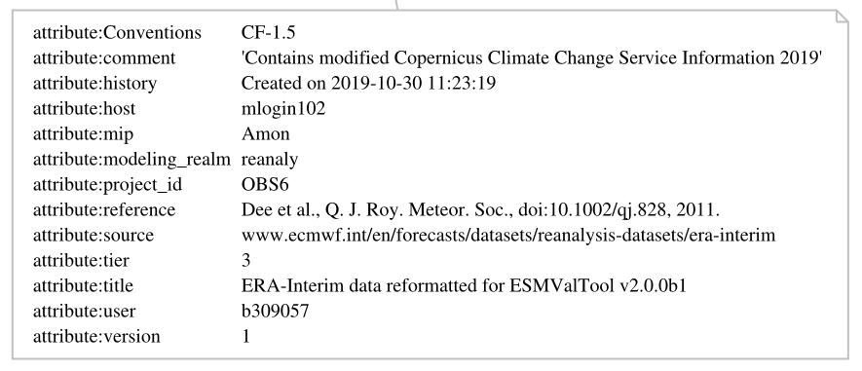
Provenance in the ESMValTool
svg-file:
reference dataset

Slide 11
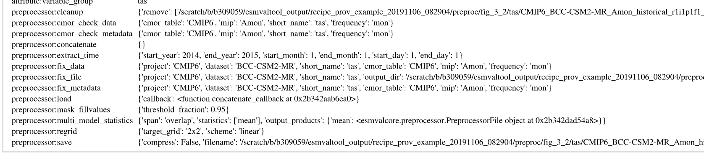
Provenance in the ESMValTool
svg-file:
preprocessor information

Slide 12
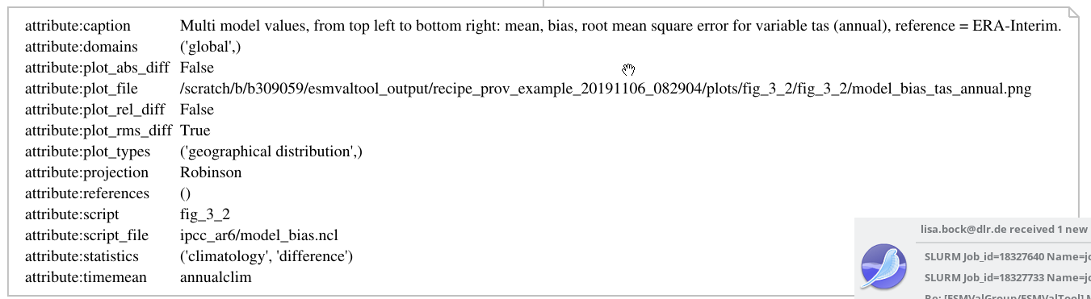
Provenance in the ESMValTool
svg-file:
diagnostic
information

Slide 13
Provenance in the ESMValTool
svg-file:

Slide 14
Integration of the ESMValTool into the CMIP6 Workflow at the DKRZ
Production phase
Data management phase
Routine evaluation
DKRZ
ESGF
Create compliance to CMIP conventions (CMORize, Metadata, etc.)
cmorized
routine
evaluation
Technical
quality control
ESGF remote
write simulation output timestep
publication
to ESGF
ESGF local
web visualization
Scientific quality control
Climate model
monitoring
native
Notes:
<Foliennummer>

Slide 15
Integration of the ESMValTool into the CMIP6 Workflow at the DKRZ
Production phase
Data management phase
Routine evaluation
DKRZ
ESGF
Create compliance to CMIP conventions (CMORize, Metadata, etc.)
cmorized
routine
evaluation
Technical
quality control
ESGF remote
write simulation output timestep
publication
to ESGF
ESGF local
web visualization
Scientific quality control
Climate model
native
monitoring
Notes:
<Foliennummer>

Slide 16
ESMValTool Quicklook-monitoring (EMAC)
Rescheduling cycle (8h)
Climate
model
ESMValTool
(core)
QL
+ append/insert new computed data to existing data file
+ (preserve provenance)
+ recreate plot with with full data
+ support for native EMAC format
Job
script
ESMValTool
(diagnostic)
QL
storage
+ updated plots
+ presented on
regular filesystem
System will be enhanced in future by the ESMValTool development team

Slide 17
Routine Evaluation
CMIP6-Daten werden vom DKRZ repliziert
Lokales CMIP6-Replika wird automatisch über das Freva-system idiziert (data browser)
Regelmäßige Erzeugung von aktualisierten recipies entsprechend der Datenverfügbarkeit (Abfrage an Freva) und dem Bedarf der Diagnostiken des ESMValTool
Entstandene Plots tragen Metadaten/Provenance-Information mit sich (notwendig zur Darstellung im Portal)
Darstellung über das Portal (Vortrag von Bianca)

Slide 18
Vielen Dank !
https://github.com/ESMValGroup/ESMValTool
https://www.esmvaltool.org/
https://esmvaltool.readthedocs.io

Slide 19
Resources
Code available at:
https://github.com/ESMValGroup/ESMValTool
https://github.com/ESMValGroup/ESMValCore
Documentation available at:
https://esmvaltool.readthedocs.io/
Installation via conda:
https://anaconda.org/esmvalgroup/esmvaltool
https://anaconda.org/esmvalgroup/esmvalcore
Issues available at:
https://github.com/ESMValGroup/ESMValTool/issues
Tutorial under development by the NL-eScience center (NLeSC):
https://github.com/ESMValGroup/tutorial
development version online at
https://esmvalgroup.github.io/tutorial/
Tutorial scheduled for the EGU 2020

