Slide 1
CMIP6 Citation Service
DICAD 11.03.2020

Slide 2
Citation: Motivation
Possibility for CMIP6 data citation was established for the first time in the history of CMIP upon a request from WGCM-CMIP
CMIP6 Citation Service is part of CMIP6 data infrastructure, part of all three CMIP6 Guidelines
CMIP6 Citation offered for input4MIPs and CMIP6 (add. requests received and to be answered)
2 Granularities for data citation: MIP/model and experiment
Provides licenses for ESGF CoG
Information gathered by CMIP6 Citation Service close the metadata gap for ESGF data LTA (AP8)
CMIP6 data references to be included in AR6 Part 1
Data impact information (use in publication) gathered as added value for data providers (dep. on implementation at publishers)
Discoverable in Google Dataset Search and catalogs harvesting DKRZ OAI or DataCite OAI servers
References:
http://cmip6cite.wdc-climate.de
WIP paper: doi:10.5281/zenodo.35178
Publication: doi:10.5334/dsj-2017-030

Slide 3
Citation: Content and Numbers (1)
Content:
Technical Components: 2 VMs (ca. 12-15 Python scripts), CERA (2 schemas used), APEX GUI, APIs, OAI Server
Interfaces: ESGF (Solr, Search API, CoG), CERA (GUI, APIs, direct), DataCite, Scholix, ES-DOC (furtherInfoUrl), Google Dataset Search (schema.org), OAI/PMH, CMIP6 CV
Projects: input4MIPs, CMIP6
Numbers:
Users: 66 Citation Managers (+replacements), ESGF Data Node Managers, Data Users
Requests: Citation Managers, data users, WIP, CDNOT, ESGF, IPCC, other interested scientists
Monitoring: ESGF, CERA, DataCite, Metadata content (incl. curation), Citation functionalities
Open Issues (2020-03-10): 4 APEX, 5 API, 22 Citation, 3 Other
DKRZ Resources: < 0.5 FTE available; 1.5-2 FTE required (0.5 technical, 1 application and user support, 0.5 coordination)
Workflow Problem:
Data Node Manager: check for citation information completeness widely not done causing additional effort for the citation to contact citation managers
References:
http://cmip6cite.wdc-climate.de

Slide 4
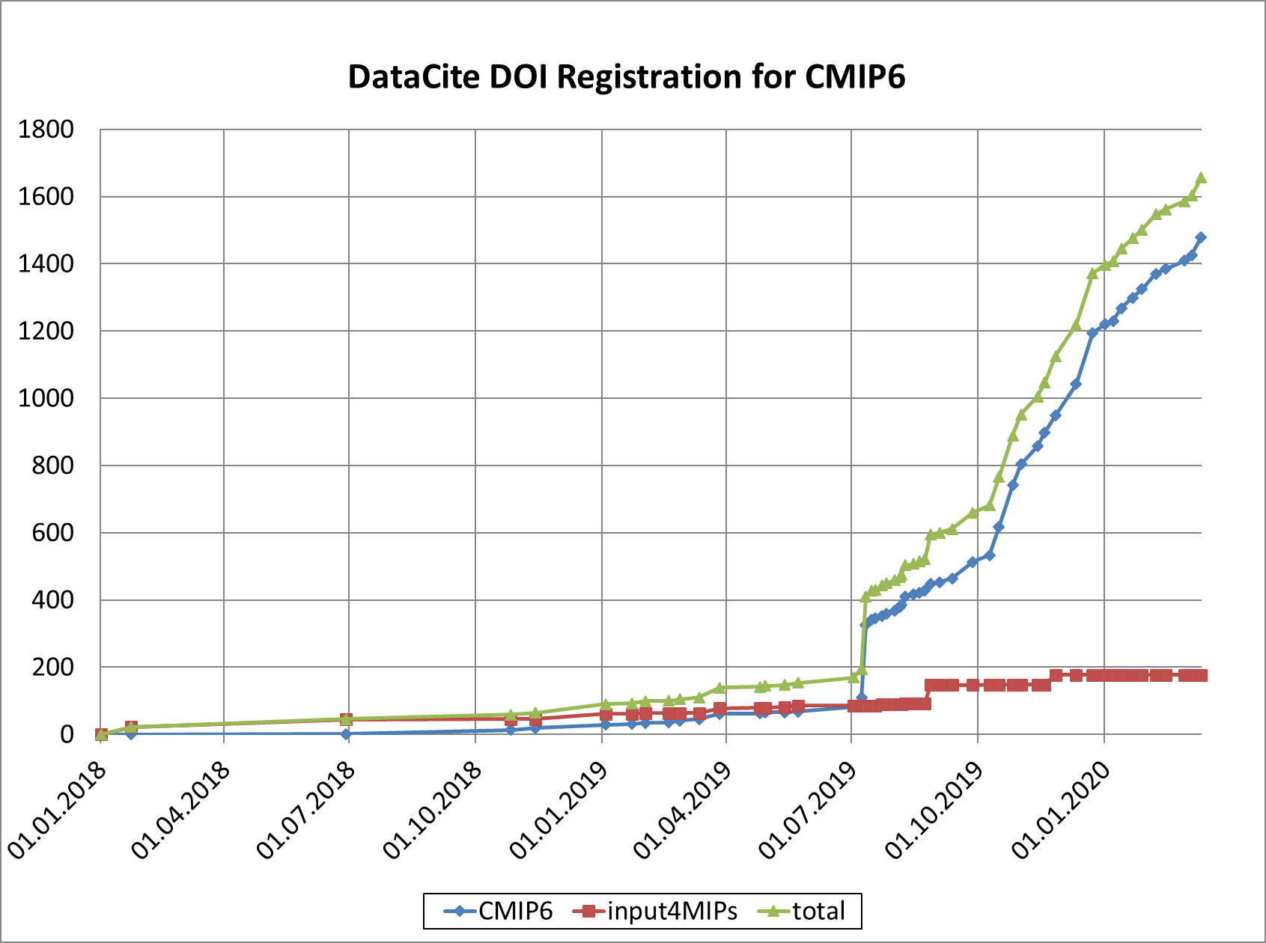
Citation: Content and Numbers (2)
DOI Status (2020-03-11):
No. DOIs:
CMIP6:
input4MIPs:
No. MD updates:
1 657
1 480
177
7 711
Reference:
http://bit.ly/CMIP6_DOI_Statistics

Slide 5
Citation: Status and Feedback
CMIP6 Citation Service has been running as prototype since early 2017.
User Feedback
Service Requests
Requirements
Data citations regarded as important
Few problems with GUI usage
More difficulties with API usage
to provide citation for additional projects
to set up a board for decisions
Technical maintenance and monitoring
Metadata curation and user support

Slide 6
Citation: Current and Future Needs
DOI registration changed from 1-hourly to 2-hourly as short-term measure
Current and Future Needs:
Monitoring of DKRZ infrastructure components by technical staff
First level support by technical staff as half of the issues are related to DKRZ infrastructure failures or instabilities
Prototype → Service: Experienced software developer as continuous second person for citation responsible for technical issues with expertise in software scalability, performance, robustness and Solr, administration experience
Citation application and development / metadata curation / user support on the long-term is an open issue

