Slide 1
AWI-CM in CMIP6
Dmitry Sein, Nikolay Koldunov, Tido Semmler, Dmitry Sidorenko, Thomas Jung

Slide 2
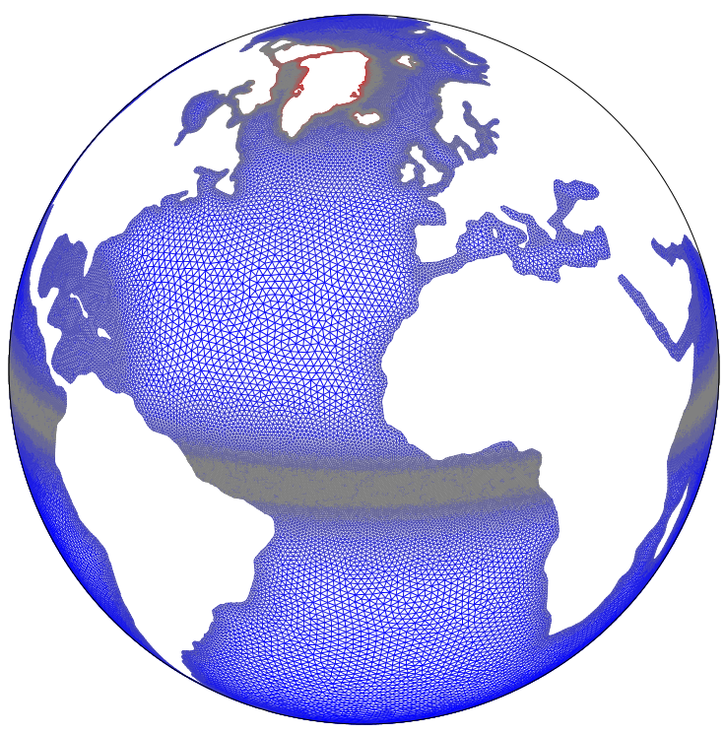
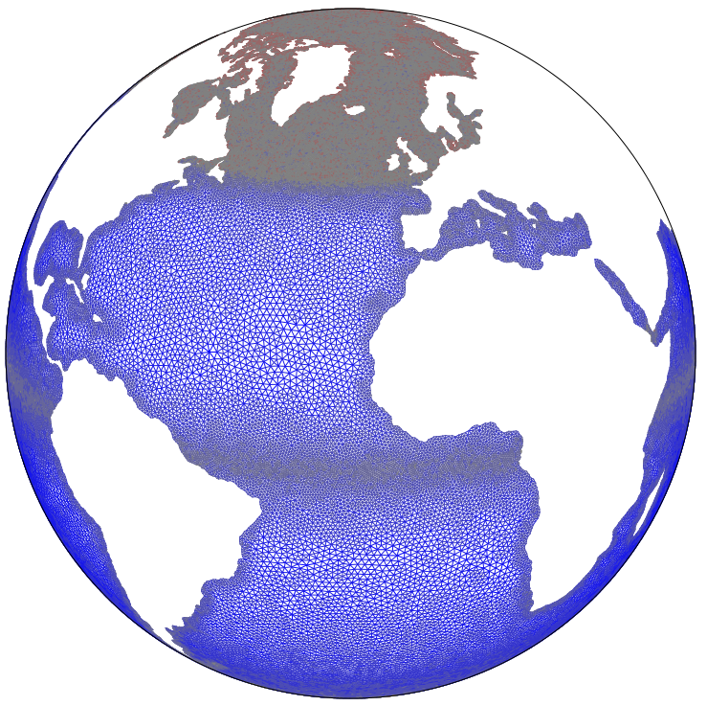
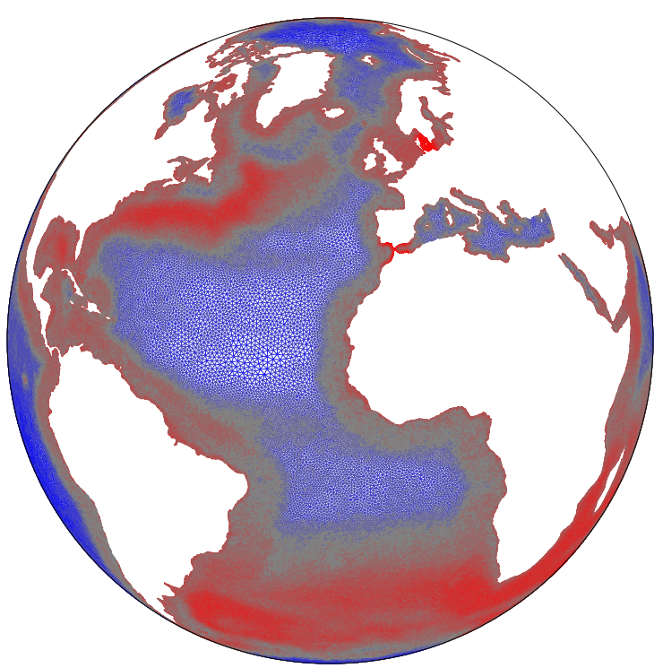
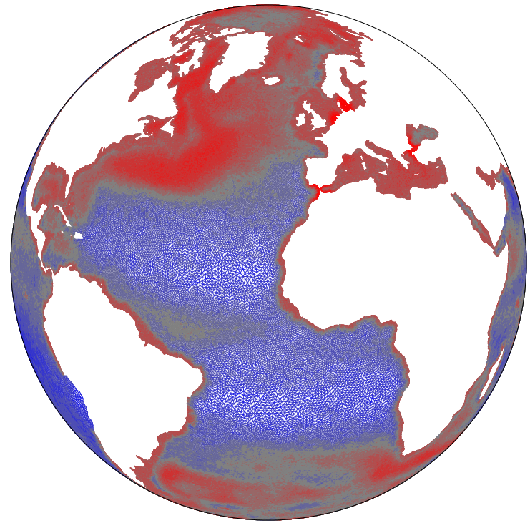
Hierarchy of ocean model grids
The flexible layout of AWI-CM (Sidorenko et al. 2015, Sein et al. 2016) allows to use eddy-resolving resolutions in key ocean areas. We exploit this capability in the North Atlantic (NA) in order to reduce long-standing biases, specifically the deep (~1000m) biases
resolution [km]
REF87K
CORE
AGUV
GLOB
top: Hierarchy of different ocean model grids. REF87K and CORE use ~1° resolution and moderate refinement
to about 25km in the tropics and in the Arctic. AGUV and GLOB focus on the Agulhas and North Atlantic current region, with different weighting between those regions.

Slide 3
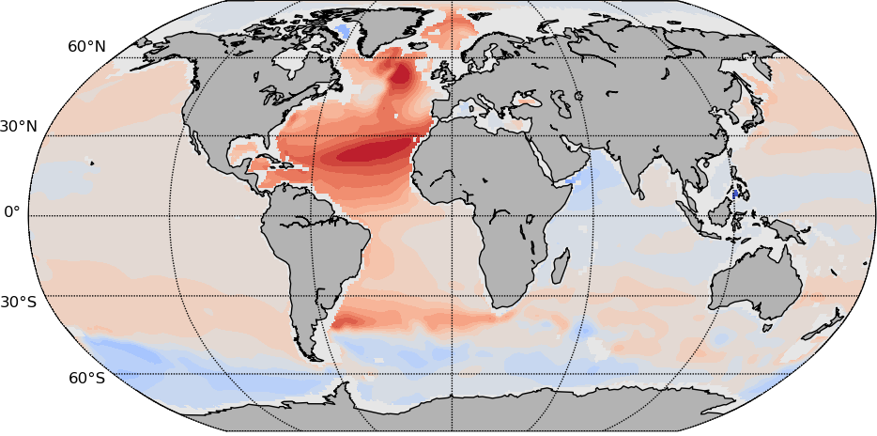
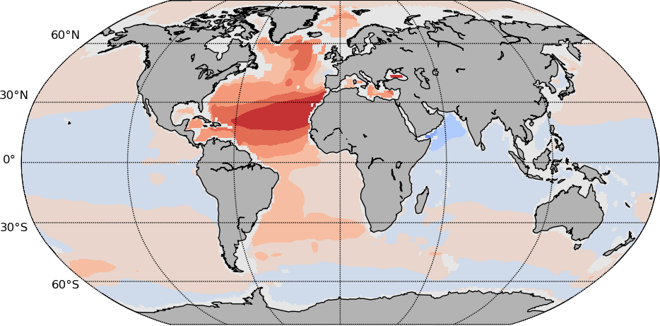
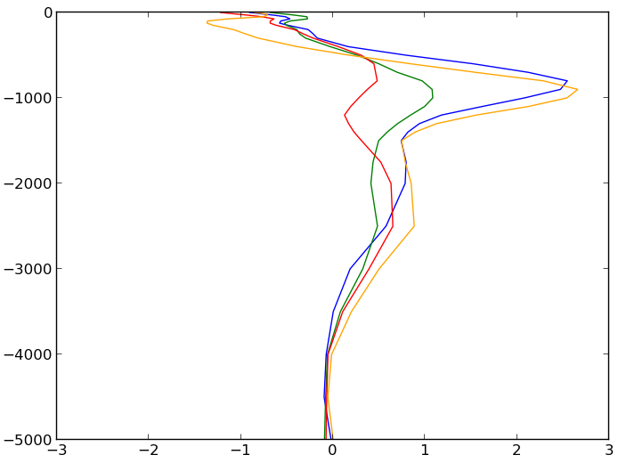
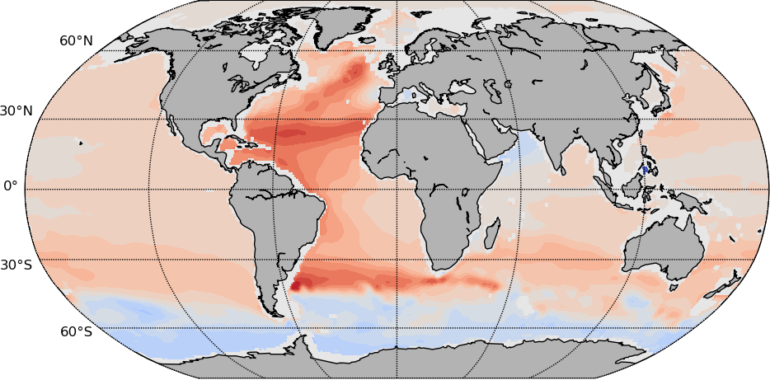
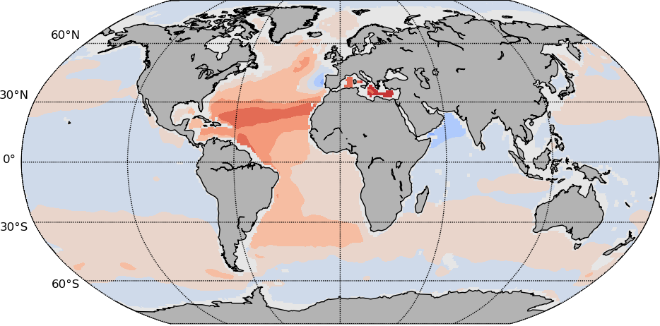
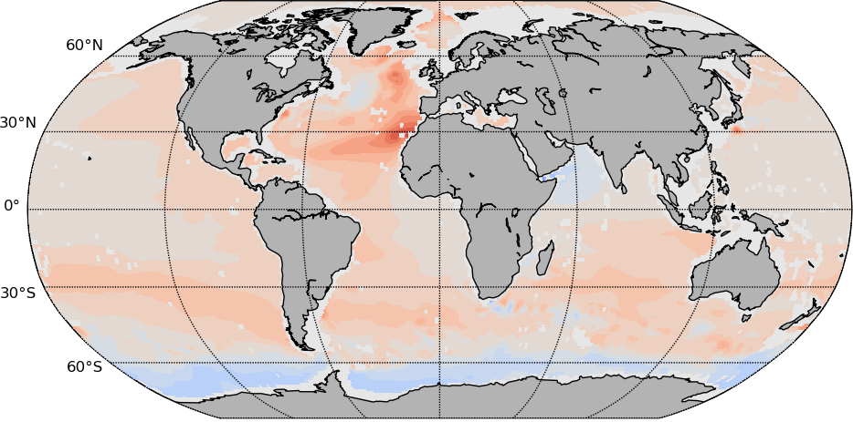
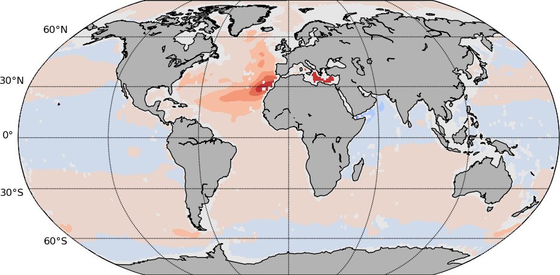
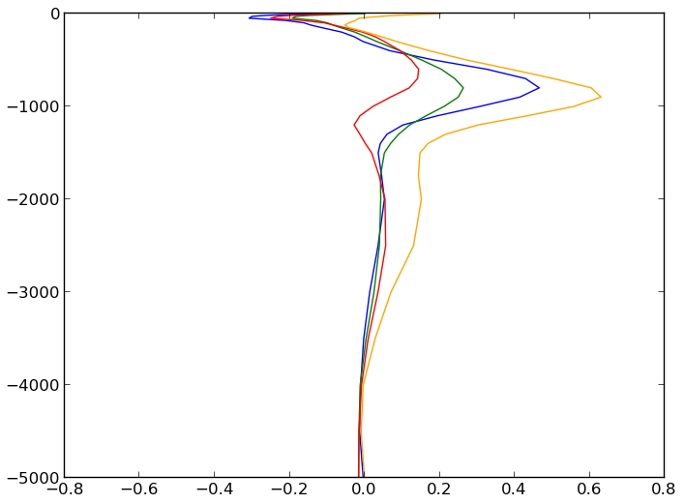
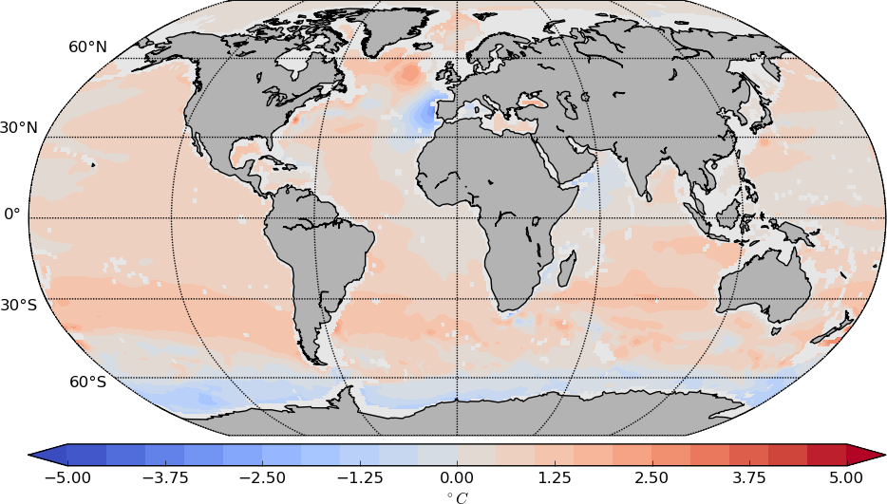
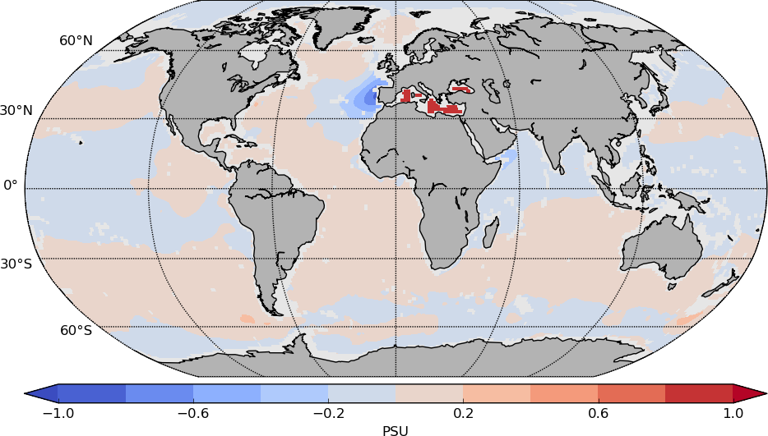
Improvements in NA deep-ocean hydrography
right: Difference of potential temperature and salinity at 1000m to the WOA2005 climatology
below: Global profiles of potential temperature and salinity, difference to the WOA2005 climatology
pot. temperature
salinity
REF87K
REF87K
temperature
CORE
CORE
T127-GLOB
T127-AGUV
T127-CORE2
T63-REF87K
AGUV
AGUV
GLOB
GLOB
salinity
Notes:
RIGHT: The years 91-100 are used. The North Atlantic biases identified in the benchmark version of AWI-CM successively decrease with increasing spatial resolution.
LEFT: Based on years 71—100 of the pre-industrial simulations .

Slide 4
Model development. 2m Temperature bias
DJF
DJF
PP KPP
JJA
JJA

Slide 5
AMOC
HR/T63
HR/T127
(Sv)

Slide 6
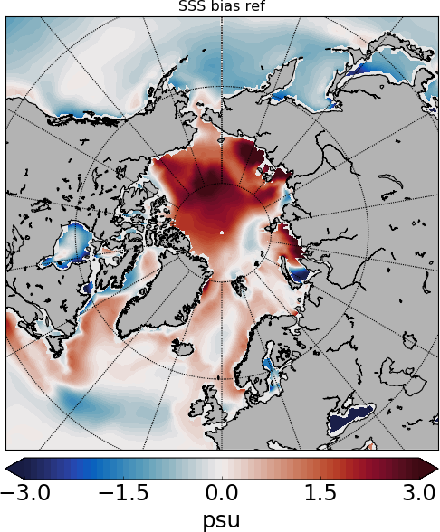
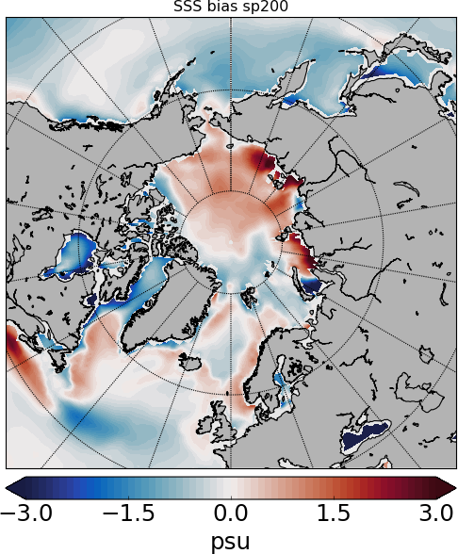
Model development. Arctic sea surface salinity bias
Salt plume parameterization

Slide 7
Current stage
The AWI-CM code for CMIP6 simulations is fixed
The preindustrial run is in progress (180 years currently)
The other DECK simulations are planned for beginning of 2018

Slide 8
Ocean diagnostics
Implemented already:
Hovmoller diagram for some ocean region.
Hovmoller diagram of T/S anomalies for some ocean region
Mean vertical profiles for some region (Now Eurasian and Amerasian basins are implemented)
Spatial distribution of surface temperature.
Spatial distribution of temperature at mean AW core level.
AW core depth and temperature
Spatial difference between Temperature and Salinity in climatology and model at different levels.

Slide 9
Ocean diagnostics
Will be implemented in the short term:
Hovmoller diagram of T/S anomalies relative to PHC for some ocean region
Vertical density profiles for regions (and anomalies)
TS diagrams for regions
Transects through key strates.
Spatial distribution of surface velocity and at depth closest to 100m
Sea ice diagnostics from Helge and Lorenzo plus standard set of SIE, SIA, SIT maps and time series

Slide 10
Example (Temperature in Eurasian Basin)
Hovmoller diagram
Mean vertical profile

Slide 11
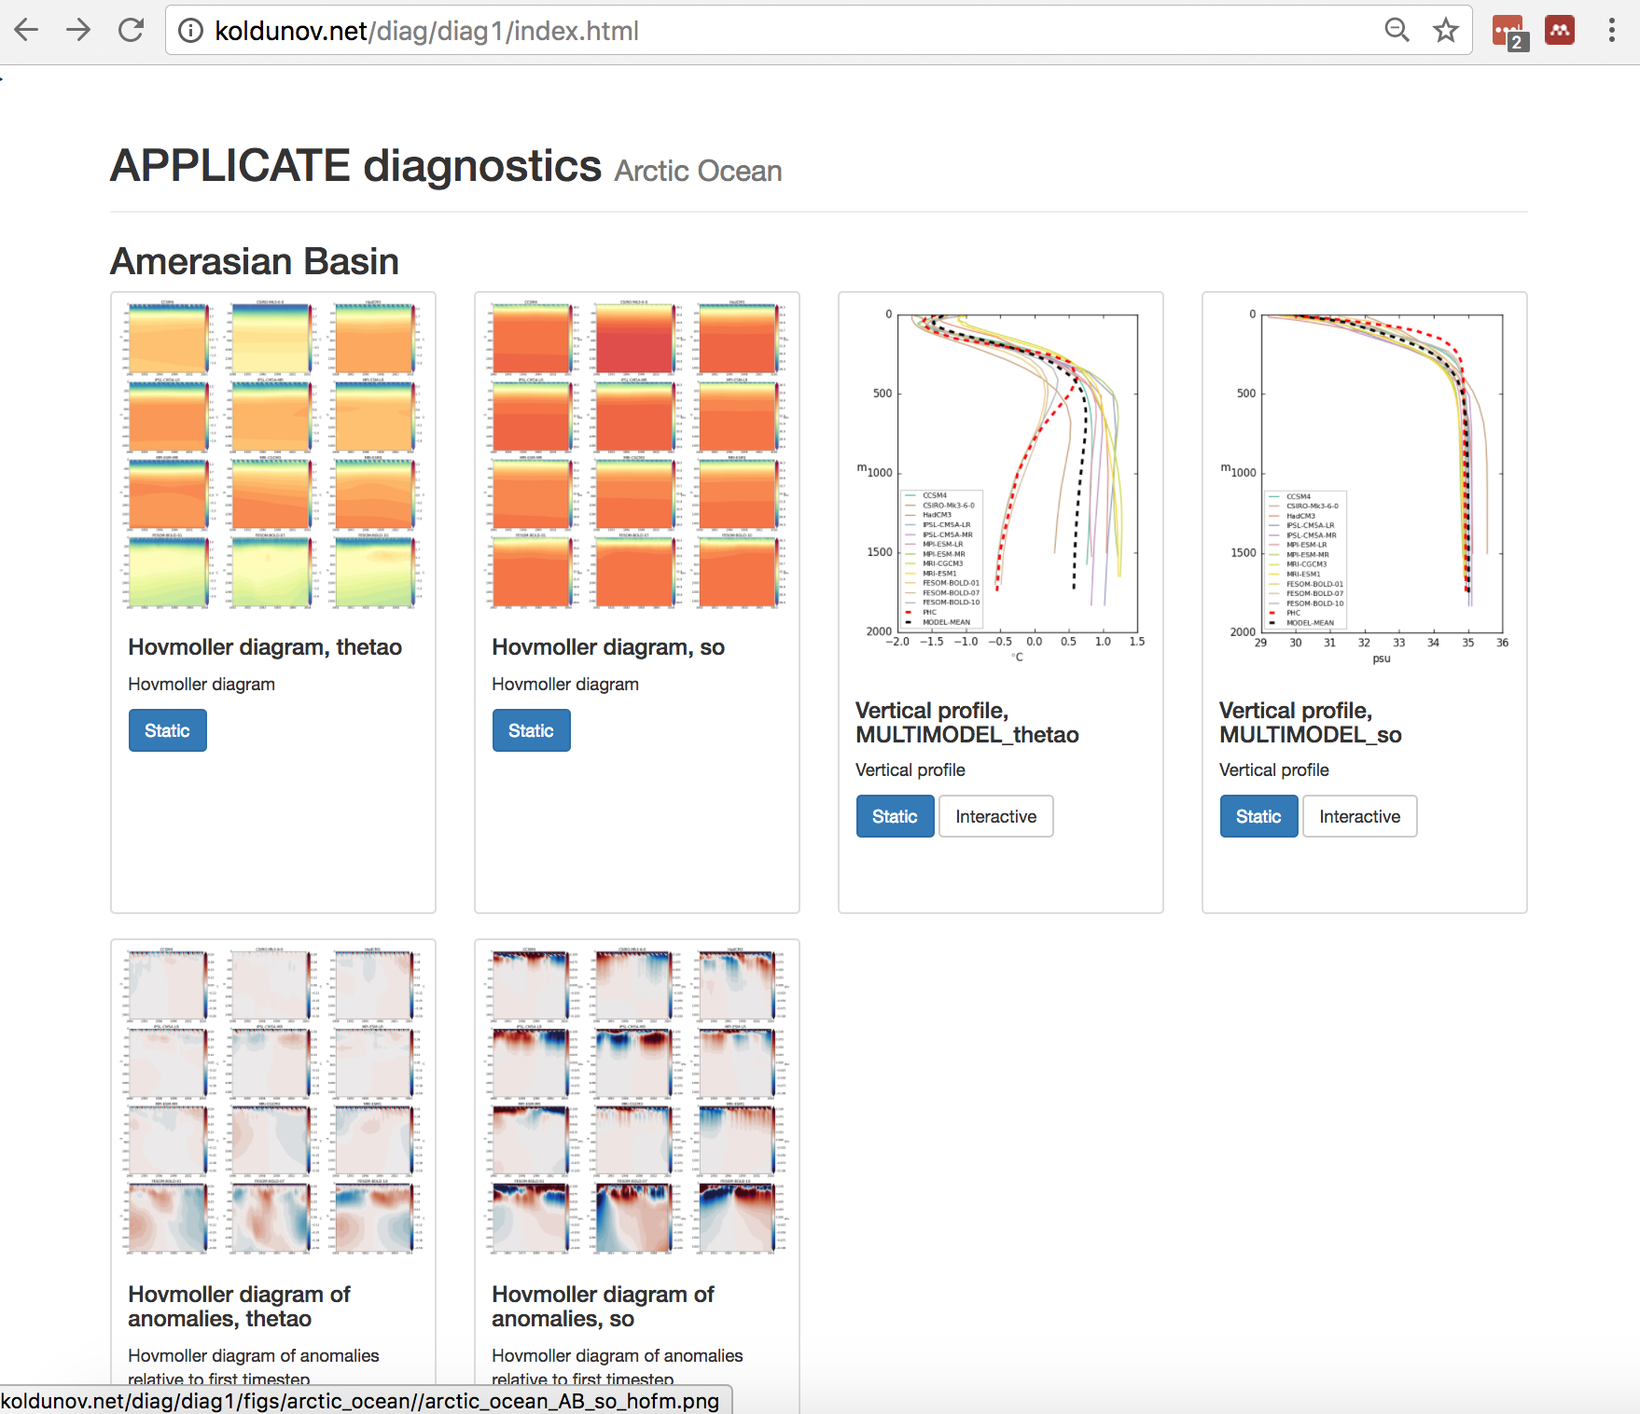
Diagnostics in the browser

