Slide 1

CMIP6-DICAD AP 6.1: Installation und Betrieb des ESMValTools in der ESGF DKRZ Infrastruktur
Björn Brötz¹, Veronika Eyring¹, Stephan Kindermann², and Carsten Ehbrecht²
¹ Deutsches Zentrum für Luft- und Raumfahrt (DLR),
Institut für Physik der Atmosphäre, Oberpfaffenhofen, Germany
² Deutsches Klimarechenzentrum, Hamburg, Germany
CMIP6-DICAD Jahrestreffen 2017
DKRZ Hamburg
11. Oktober 2017

Slide 2
Workflow for Model Evaluation in CMIP5 & CMIP6
Workflow for model evaluation during CMIP5:
Local download of high volume data => multiple copies at many institutions
    Time and resource intensive
    Local archive could quickly get outdated
    Need to preserve metadata in the final result
Duplication of efforts by non coordinated development of diagnostic code
Evaluation by individual scientists (whenever they had time) => delays in the availability of a comprehensive assessment of the CMIP5 ensemble
Envisaged workflow for model evaluation in CMIP6 (Eyring et al., ESD, 2016):
  More coordination of software efforts because over the last several years, community evaluation tools have been developed as open source software
  the ESGF nodes have been expanded with processing capabilities so that the tools can run alongside the ESGF as soon as the output is published
  Evaluation tools will ensure traceability & reproducibility of evaluation results
    The resulting enhanced systematic characterization of models would identify strengths & weaknesses of the simulations more quickly and openly to the community, which will also support model development & assessments (e.g. IPCC)

Slide 3
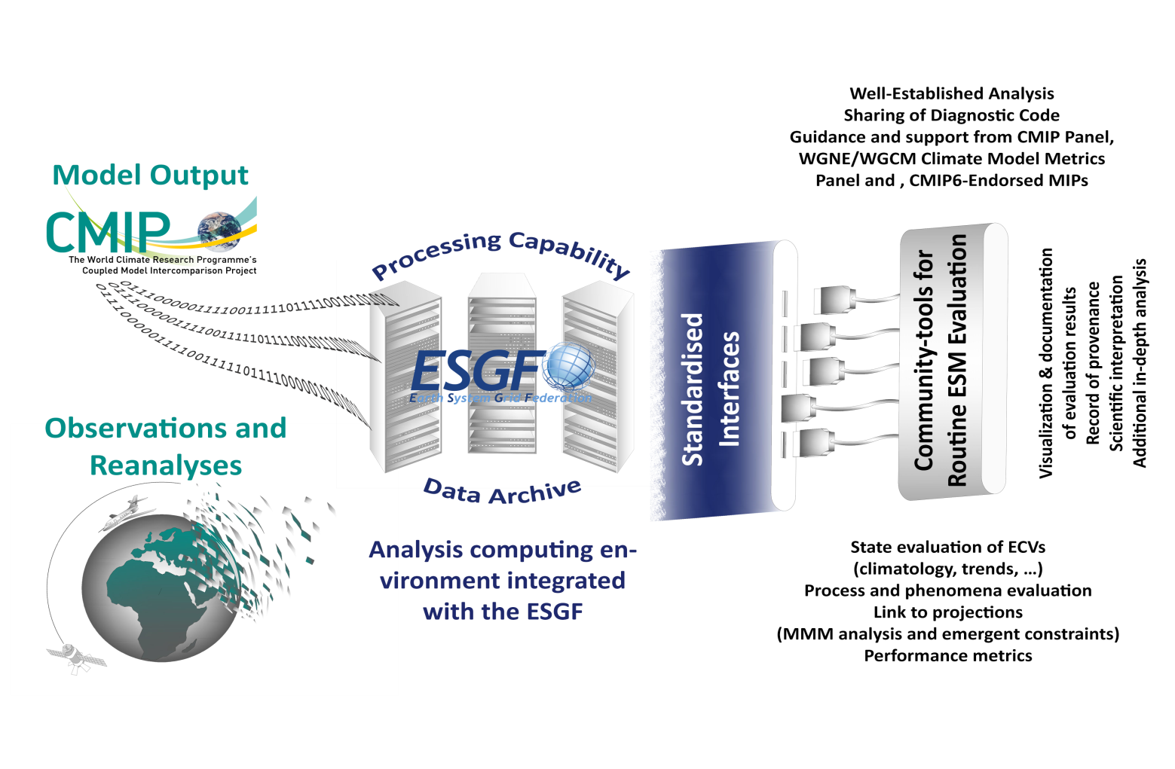
Envisaged Workflow for Model Evaluation in CMIP
We argue that the community has reached a critical juncture at which many baseline aspects of ESM evaluation need to be performed much more efficiently
This activity also aims to assist modelling groups in improving their models
Running alongside the ESGF, as soon as the output is published
Eyring et al., ESD (2016)

Slide 4
CMIP6 Workflow with the ESMValTool at the DKRZ*
Production phase
Data management phase
Routine evaluation
DKRZ
ESGF
Create compliance to CMIP conventions (CMORize, Metadata, etc.)
cmorized
routine
evaluation
Technical
quality control
ESGF remote
write simulation output timestep
publication
to ESGF
ESGF local
web visualization
Scientific quality control
MPI-ESM
MPI-ICON
monitoring
EMAC
native
*Defined in the Project CMIP6-DICAD
freva: https://freva.met.fu-berlin.de

Slide 5
Integration for routine evaluation
Routine evaluation by combining synda and the ESMValTool.
Synda acts as a daemon listening for changes on the ESGF
Upon a successful replication step the ESMValTool will be called from synda to act on the new data

Slide 6
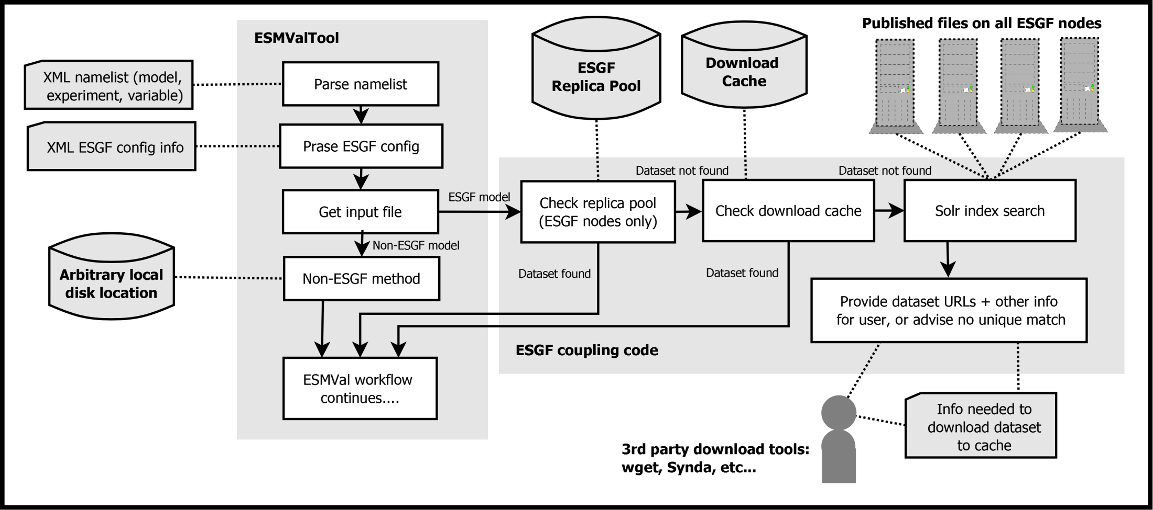
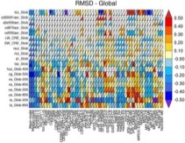

ESMValTool Workflow for routine evaluation at the ESGF (CMIP6-DICAD)
Synda deamon
triggers
plot
Web based Visualisation
Step-wise access:
ESMValTool core team
Modelling groups
Public
netCDF
log file
Derived from: Eyring et al., ESMValTool v1.0, GMD, 2016

Slide 7
ESGF Pool at DKRZ
(1) CMIP5 and CMIP6 Data
  /work/kd0956/
    CMIP5, CORDEX, OBS4MIPS, PMIP3,..
  Current volume: 1.3 PByte
(2) Observational Data
  /work/kd0956/OBS/bk1020 (group 1020)
  Current volume: 0.5 TB
    Tier1, Tier2, Tier3

Slide 8
ESMValTool Related Milestones in CMIP6-DICAD
- Standardisierte Diagnostiken und Modellevaluation (AP6) -
M1: Entwurf mit ausführlicher Spezifikation zum Portal [Monat 6, FUB]
M2: Prototype ESMValTool Version läuft in der ESGF DKRZ Infrastruktur [Monat 9, DKRZ]
M3: ESMValTool steht zur operationellen Laufüberwachung in der DKRZ Infrastruktur zur Verfügung [Monat 12, DLR]
M4: Lauffähiger und getesteter Prototype für das Portal [Monat 15, FUB]
M5: ESMValTool mit erweiterten Diagnostiken auf CMIP5 Modelldaten angewandt [Monat 18, DLR]
M6: ESMValTool mit CMIP6 Modelldaten und Beobachtungsdaten vollständig integriert in der ESGF DKRZ Infrastruktur [Monat 24, DKRZ]
M7: MPI-ESM1/2 und EMAC2 mit erweiterter ESMValTool Version evaluiert und mit anderen CMIP6 Modellen verglichen [Monat 36, DLR]
M8: Produktionssystem des Portals ist installiert [Monat 36, FUB]
AP 6.1 Milestone
AP 6.1 Milestone
=> Work in AP6.1 on time

Slide 9
CMIP6-DICAD AP 6.2: Nutzung des ESMValTools zur QA laufender Simulationen
Björn Brötz¹, Veronika Eyring¹, Stephan Kindermann², and Carsten Ehbrecht²
¹ Deutsches Zentrum für Luft- und Raumfahrt (DLR),
Institut für Physik der Atmosphäre, Oberpfaffenhofen, Germany
² Deutsches Klimarechenzentrum, Hamburg, Germany
CMIP6-DICAD Jahrestreffen 2017
DKRZ Hamburg
11. Oktober 2017

Slide 10

ESMValTool Quicklook System @ DKRZ
Mistral
Modvis webserver
Climate model
job script
Rescheduling
cycle (8h)
Quicklook
system
Web application
data storage
cron/rsync

Slide 11
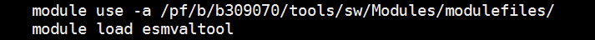
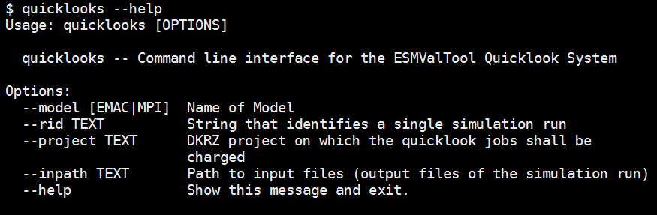
Call from job script:

Slide 12
Demo websites for MPI and EMAC
https://modvis.dkrz.de/bd0854/quicklooks/demo/mpi
https://modvis.dkrz.de/bd0854/quicklooks/demo/emac
Username: demoCMIP6
Password: QuicklookCMIP6

Slide 13
ESMValTool Related Milestones in CMIP6-DICAD
- Standardisierte Diagnostiken und Modellevaluation (AP6) -
M1: Entwurf mit ausführlicher Spezifikation zum Portal [Monat 6, FUB]
M2: Prototype ESMValTool Version läuft in der ESGF DKRZ Infrastruktur [Monat 9, DKRZ]
M3: ESMValTool steht zur operationellen Laufüberwachung in der DKRZ Infrastruktur zur Verfügung [Monat 12, DLR]
M4: Lauffähiger und getesteter Prototype für das Portal [Monat 15, FUB]
M5: ESMValTool mit erweiterten Diagnostiken auf CMIP5 Modelldaten angewandt [Monat 18, DLR]
M6: ESMValTool mit CMIP6 Modelldaten und Beobachtungsdaten vollständig integriert in der ESGF DKRZ Infrastruktur [Monat 24, DKRZ]
M7: MPI-ESM1/2 und EMAC2 mit erweiterter ESMValTool Version evaluiert und mit anderen CMIP6 Modellen verglichen [Monat 36, DLR]
M8: Produktionssystem des Portals ist installiert [Monat 36, FUB]
=> Work in AP6.2 on time

