Slide 1
AP7/AP8: Long-Term Archival of CMIP6 Data
DICAD, 24.01.2017

Slide 2
IPCC Data Distribution Centre (IPCC DDC)

Slide 3
IPCC Data Distribution Centre at WDCC
IPCC DDC (Data Distribution Centre) – ipcc-data.org jointly managed by:
British Atmospheric Data Centre (BADC): climatology
World Data Center Climate (WDCC) at DKRZ: Reference Data Archive for climate model output
Center for International Earth Science Information Network (CIESIN) at Columbia University: social-economic data archive
→ Certified ICSU World Data System (WDS) members
Reference Data Archive for Climate Model Output
The Reference Data Archive provides data on the long-term for an interdisciplinary user community and in support of the IPCC Authors.

Slide 4
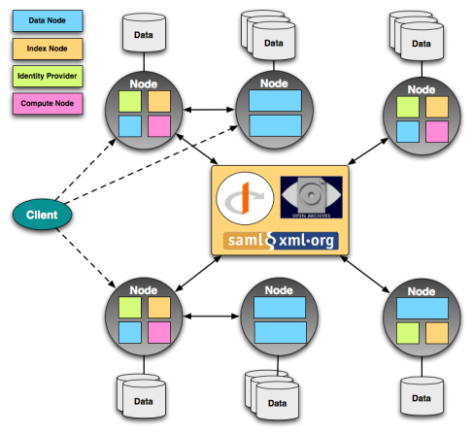
IPCC DDC Data Services for AR6
Data Creator
IPCC Author
IPCC DDC User
IPCC DDC AR6 Services
Earth System Grid Federation (ESGF)
CMIP Data Pool
IPCC DDC Reference Data Archive
CMIP6 (subset)
AR6
Replication
Long-Term Archival
CMIP5
AR5
CORDEX
AR4
Derived Products
AR3
Analysis Input
AR2

Slide 5
Coordination Efforts
Coordination between IPCC DDC and IPCC Working Groups
Discussions between DDC Manager and WG I and II have been started in 01/2016 and continued in 09/2016:
The contact for the DDC is a TSU member of WG II, which will coordinate IPCC WG requirements with the TSUs of WG I and WG III after a general discussion about data requirements among the WG co-chairs.
Coordination with WGCM Infrastructure Panel and Infrastructure Partners
Accessibility of ancillary metadata by DRS_id by integration of URL into ESGF index (ESGF working team lead)

Slide 6
Long-Term Data Archival:
Provide data on the long-term for an interdisciplinary user community
= Data (AP8) + Metadata (AP7)

Slide 7
Long-Term Archival Workflow
II. Federated Projects
I. DKRZ or Central Projects
1
Transfer of Data
WDC Climate at DKRZ
by WDCC
1
Delivery of
Data
1
Transfer of Use
MD by WDCC
Temporary Storage
1
Delivery of
Data and Metadata Creators
Ancillary Metadata
Metadata
Data Creator
1
Transfer of ancill.
MD by WDCC
Technical
2
Quality Assurance
3
Long-Term Archival
Long-Term Archive
CERA2 Metadata
4
DataCite DOI
Publication Process

Slide 8
Before LTA: CMIP6 Workflow
Workflow for CMIP6 project phase
WGCM Infrastructure Panel (WIP) defines standards for data and data documentation (ancillary metadata).
Registration of institute and model at: https://github.com/WCRP-CMIP/CMIP6_CVs
Contact your local data node for data publication: DKRZ: esgf-publishing@dkrz.de
Contact repositories for ancillary metadata on details how to provide your metadata

Slide 9
Ancillary Metadata for CMIP6
Ancillary metadata for CMIP6:
CIM model and simulation documentations (http://es-doc.org)
Data citation information → WIP email (http://cmip6cite.wdc-climate.de; GUI: http://cera-www.dkrz.de/citeXA)
Annotation service developed by IPSL and additional information hosted by the institutions and integrated in furtherInfoUrl web page.
to scholarly publications and data (part of Citation and CMIP6 Publication Services)
Documentation of data quality
Citation:
Errata:
References:
ESMVal or other QA Documentation:
→Part of Data Documentation in Reference Data Archive

Slide 10
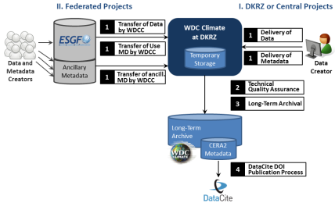
Long-Term Data Archival: Progress
Step 1: Transfer CMIP6 Data
and Create Use Metadata
Integration of Use Metadata (NetCDF Header) in Archive:
Develop structured XML templates for transfer of metadata from ESGF to CERA DB
Revise mapping of use metadata to CERA2 schema

Slide 11
Next Steps
Goals for next steps:
IPCC DDC:
IPCC cross-WG Co-Chair's discussion on CMIP6 data requirements initiated by TSUs → integrate IPCC WG data requirements into CMIP6 data pool discussions
Long-Term Archival:
Enhance structured XMLs to define first working version
Check plausibility and completeness of use metadata to be inserted into CERA2 schema
Try mapping with test data
Citation information mapping to CERA2 schema and technical realization

Slide 12
Summary
IPCC DDC:
New IPCC DDC service (CMIP data pool) in discussion with IPCC WGs
LTA requirements implemented into ESGF (ancillary MD)
Long-Term Archival: Interface for ingest of use metadata from NetCDF headers is investigated.

Slide 13
History of IPCC DDC
1995: IPCC SAR climate model data long-term archived
1998: IPCC DDC formally established
2008: parts of FAR data added to DDC
2013/14: IPCC DDC AR5 data long-term archival
2016: IPCC Task Force built for transformation of the organization of IPCC data and information to serve the needs of the IPCC during and beyond AR6.
2020/21: IPCC DDC AR6 long-term archival
Notes:
FAR: NCAR comparable role to ETH Zurich in AR5

