Slide 1

CMIP6-DICAD AP 6.1: Installation und Betrieb des ESMValTools in der ESGF DKRZ Infrastruktur
Stephan Kindermann¹, Björn Brötz², Veronika Eyring², and Carsten Ehbrecht¹
¹ Deutsches Klimarechenzentrum, Hamburg, Germany
² Deutsches Zentrum für Luft- und Raumfahrt (DLR),
Institut für Physik der Atmosphäre, Oberpfaffenhofen, Germany
CMIP6-DICAD Jahrestreffen 2017
DKRZ Hamburg
24. Januar 2017

Slide 2
Workflow for Model Evaluation in CMIP5 & CMIP6
Workflow for model evaluation during CMIP5:
Local download of high volume data => multiple copies at many institutions
    Time and resource intensive
    Local archive could quickly get outdated
    Need to preserve metadata in the final result
Duplication of efforts by non coordinated development of diagnostic code
Evaluation by individual scientists (whenever they had time) => delays in the availability of a comprehensive assessment of the CMIP5 ensemble
Envisaged workflow for model evaluation in CMIP6 (Eyring et al., ESD, 2016):
  More coordination of software efforts because over the last several years, community evaluation tools have been developed as open source software
  the ESGF nodes have been expanded with processing capabilities so that the tools can run alongside the ESGF as soon as the output is published
  Evaluation tools will ensure traceability & reproducibility of evaluation results
    The resulting enhanced systematic characterization of models would identify strengths & weaknesses of the simulations more quickly and openly to the community, which will also support model development & assessments (e.g. IPCC)

Slide 3
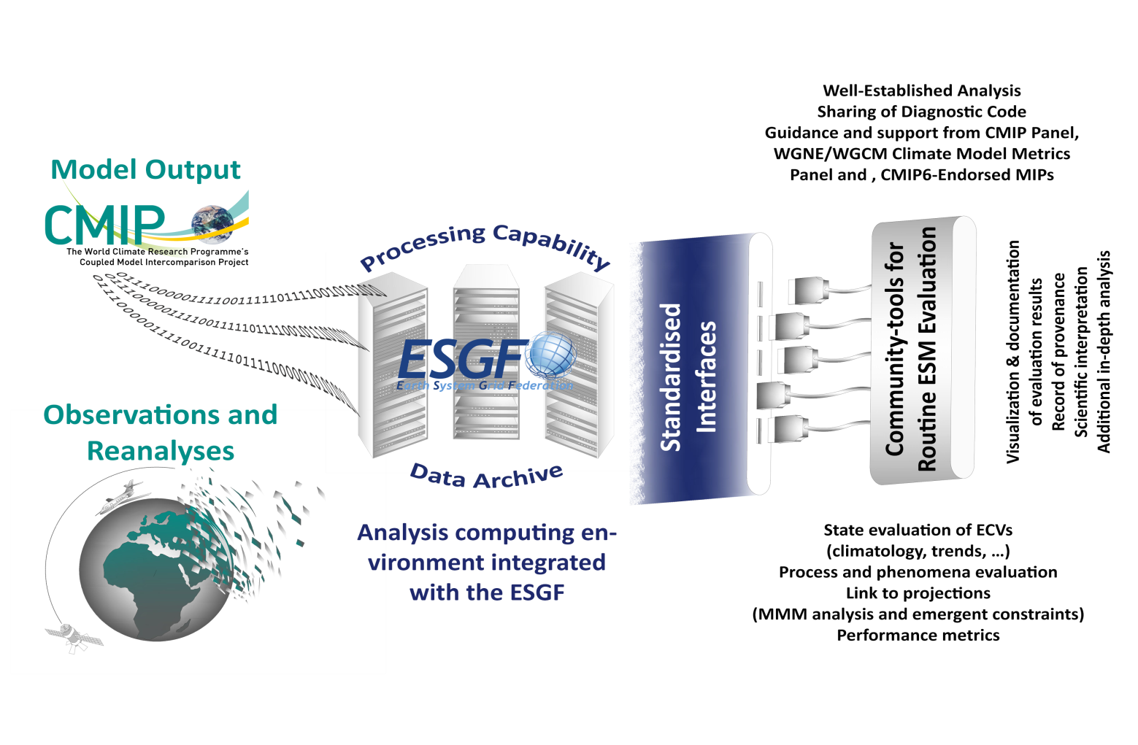
Envisaged Workflow for Model Evaluation in CMIP
We argue that the community has reached a critical juncture at which many baseline aspects of ESM evaluation need to be performed much more efficiently
This activity also aims to assist modelling groups in improving their models
Running alongside the ESGF, as soon as the output is published
Eyring et al., ESD (2016)

Slide 4
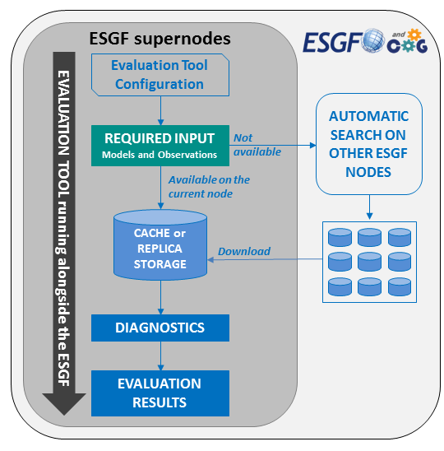
Envisaged Workflow for Model Evaluation in CMIP6
- Quasi-operational / Centrally executed / Data to Code -
Due to the high volume of the data in CMIP6, ESGF replication is likely to be slow (took months in CMIP5)
It was therefore recommended to the ESGF teams that the data used by the CMIP evaluation tools be replicated with higher priority => will be done by DKRZ
This should substantially speed up the evaluation of model results after submission of the simulation output to the ESGF
Eyring et al., ESD (2016)

Slide 5
CMIP6 Workflow with the ESMValTool at the DKRZ*
Production phase
Data management phase
Routine evaluation
DKRZ
ESGF
Create compliance to CMIP conventions (CMORize, Metadata, etc.)
cmorized
routine
evaluation
Technical
quality control
ESGF remote
write simulation output timestep
publication
to ESGF
ESGF local
web visualization
Scientific quality control
MPI-ESM
MPI-ICON
monitoring
EMAC
native
*Defined in the Project CMIP6-DICAD
freva: https://freva.met.fu-berlin.de

Slide 6
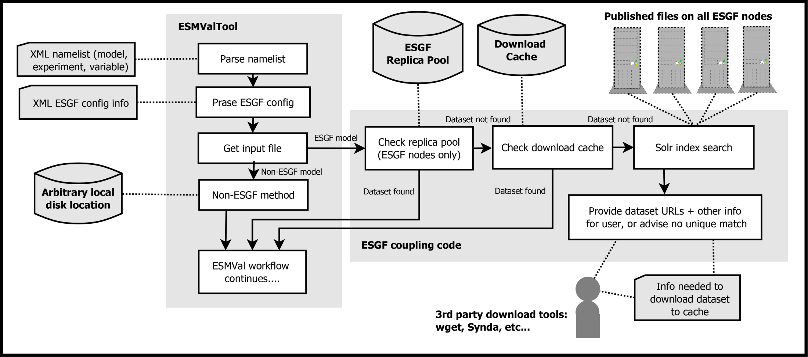
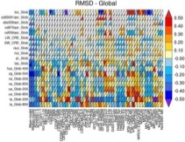

ESMValTool Workflow for routine evaluation at the ESGF (CMIP6-DICAD)
Download data to Cache
plot
Web based Visualisation
Step-wise access:
ESMValTool core team
Modelling groups
Public
netCDF
log file
Derived from: Eyring et al., ESMValTool v1.0, GMD, 2016

Slide 7
ESGF Coupling
(1) ESMValTool can read files from ESGF node cache
  Path structure of each ESGF node cache is described in new ESGF config file, based on XML
  Structure of node cache differs slightly between ESGF nodes, ESMValTool takes account of this so namelists are easily ported between ESGF sites
  New ESGF project classes and config file fully documented
(2) ESMValTool will find remote files using “Solr” index search
  If dataset not in ESGF node cache, or no access to ESGF node cache, ESMValTool can search custom local cache
  If dataset not available locally, ESMValTool will perform Solr index search on ESGF using info provided in model line
(3) ESMValTool will assist with download of remote files
  If remote dataset found, ESMValTool will provide URLs of required files, so user/administrator can download
  May be possible to provide user with a text file containing config information for Synda, making downloading files even easier (but at the moment there needs to be a human being involved, it can’t be fully automated)
=> Already implemented

Slide 8
Integration for routine evaluation
Next steps
Routine evaluation is planed to be realized by combining synda and the ESMValTool.
Synda acts as a daemon listening for changes on the ESGF
Upon a successful replication step the ESMValTool will be called from synda to act on the new data

Slide 9
ESGF Pool at DKRZ
(1) CMIP5 and CMIP6 Data
  /work/kd0956/
    CMIP5, CORDEX, OBS4MIPS, PMIP3,..
  Current volume: 1.3 PByte
(2) Observational Data
  /work/kd0956/OBS/bk1020 (group 1020)
  Current volume: 0.5 TB
    Tier1, Tier2, Tier3

Slide 10
Reproducibility & Traceability of evaluation results
Namelist
Evaluation analysis is controlled by the namelist file that defines the internal workflow for the desired analysis.
It defines:
Input datasets (observations, models)
Regridding operation (if needed)
Set of diagnostics
Misc. (output formats, output folder, etc…)
Logfile
At each execution of the tool a log file is automatically created
The log file contains:
The list of all input data which have been used (version, data source, etc.)
The list of variables that have been processed
The list of diagnostics that have been applied
The list of authors and contributors to the given diagnostic, together with the relevant references and projects
Software version of ESMValTool that was used
Output files (NetCDF)
Contain meta data from input files and meta data generated by ESMValTool
Observational data
Well defined processing chain
creation of metadata

Slide 11
ESMValTool Related Milestones in CMIP6-DICAD
- Standardisierte Diagnostiken und Modellevaluation (AP6) -
M1: Entwurf mit ausführlicher Spezifikation zum Portal [Monat 6, FUB]
M2: Prototype ESMValTool Version läuft in der ESGF DKRZ Infrastruktur [Monat 9, DKRZ]
M3: ESMValTool steht zur operationellen Laufüberwachung in der DKRZ Infrastruktur zur Verfügung [Monat 12, DLR]
M4: Lauffähiger und getesteter Prototype für das Portal [Monat 15, FUB]
M5: ESMValTool mit erweiterten Diagnostiken auf CMIP5 Modelldaten angewandt [Monat 18, DLR]
M6: ESMValTool mit CMIP6 Modelldaten und Beobachtungsdaten vollständig integriert in der ESGF DKRZ Infrastruktur [Monat 24, DKRZ]
M7: MPI-ESM1/2 und EMAC2 mit erweiterter ESMValTool Version evaluiert und mit anderen CMIP6 Modellen verglichen [Monat 36, DLR]
M8: Produktionssystem des Portals ist installiert [Monat 36, FUB]
AP 6.1 Milestone
AP 6.1 Milestone
=> Work in AP6.1 on time

