Slide 1
Data Citation Service for CMIP6 and IPCC DDC Aspects
CMIP6/AR6 Project Kickoff, 19.07.2016

Slide 2
I. Citation: Workflow Overview
Provide Citation Information
Update Citation Information
Citation Information fixed
DataCite DOI Registration
ESGF and CMIP data pool (CDP)
Long-Term Data Archival
IPCC DDC Reference Data Archive
ESGF and CDP
Answer CMIP6 Call for Mod. Centers
Model Runs and CMOR
Additional and Corrected Dataset Versions
CMIP6 – dynamic data
AR6 – stable data
CMIP6 Call to Mod. Centers
IPCC WGI AR6 Submission Deadline
Time

Slide 3
I. Citation: Motivation
Request from WGCM: Make CMIP6 data citable prior to Long-Term Archival in the IPCC-DDC.

Slide 4
I. Citation: Situation in CMIP5
Situation in CMIP5
DOI Citation
CMIP5 Data
ca. 2-3 years
IPCC-DDC Data

Slide 5
I. Citation: Concept for CMIP6 (1)
Concept for CMIP6
Early Citation
DOI Citation
closely inter-related
CMIP6 Data
ca. 2-3 years
IPCC-DDC Data

Slide 6
I. Citation: Concept for CMIP6 (2)
Concept for CMIP6
Early Citation
DOI Citation
Creators (PubYear): Title. Version. Publisher. PID.
closely inter-related
Creators (PubYear): Title. WDCC. DataCite DOI.
Citation Granularities: Model Data and Experiment Data
Early Citations include Versions for the identification of used datasets.

Slide 7
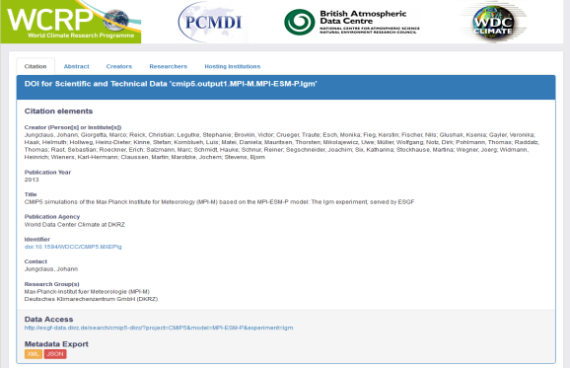
I. Citation: Data Citation Service
Archive
User
REQUEST for citation by controlled names (DRS)
Citation Service
Citation information
DISPLAY option
DATA option
XML
JSON
Creators
Title
Publication Year
Publisher
PID
Contributors
…

Slide 8
I. Citation: Human Users
Data Creator:
insert/update citation information
Data User / Article Writer:
access citation information
Data Reviewer / Article Reader:
access cited data
Oracle APEX GUI
CoG
Publisher Portal
Insert / Update Citation
Access “Data Citation” Link
Access “Data Access” Link
Access Data by DOI via Landing Page
Landing Page
Citation Service
Provide Information

Slide 9
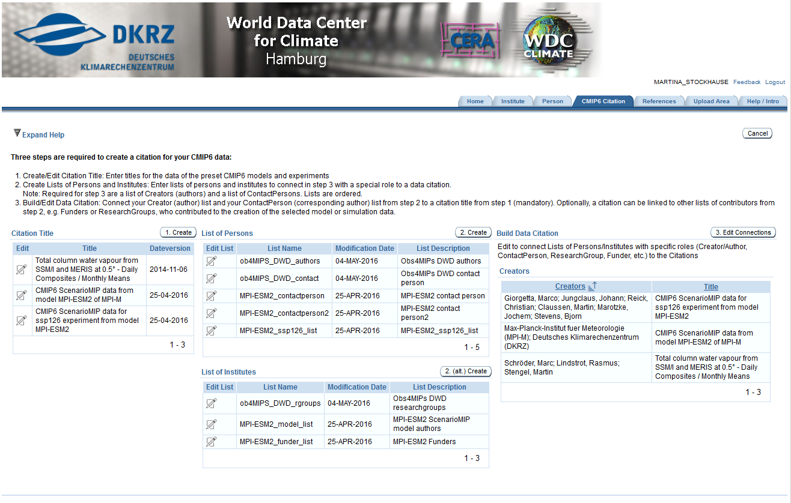
I. Citation: Data Creators
Use Case 1: Providing Citation Information
Citation APEX GUI:
Data Creator
Oracle APEX GUI
Insert / Update Citation
Insert / update citation information, which is immediately visible.
Citation information can be updated until the submission deadline for IPCC AR6 WGI
Citation Service
http://cera-www.dkrz.de/citeXA (not yet available)

Slide 10
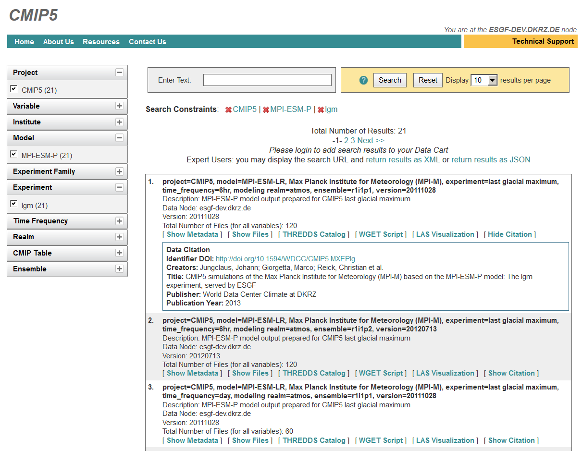
I. Citation: Data Users
Use Case 2: Preparing an Article
Search for Citation Information in
ESGF CoG Portal
Data User / Citer
Based on DRS
CoG
Citation Landing Page
Access “Data Citation” Link
Citation Service
http://esgf-data.dkrz.de
The ESGF implementation is coordinated by ESGF-QCWT.

Slide 11
I. Citation: Article Readers or Reviewers
Use Case 3: Access Data underlying an Article
Find Data Citation in reference list of an article, e.g.:
Data Reviewer / Article Reader
Jungclaus et al. (2012): The MPI….. v20130807. WDCC. doi:10.1594/WDCC/CMIP5.MXEPc1.
Publisher Portal
Citation Landing Page
Resolve DOI
Access DOI
+ version information
Citation Service
Landing Page
Access “Data Access“ Link
+ version information
CoG
Filter with version information + Access Data
ESGF CoG Portal
Version Dependency !

Slide 12
I. Citation: Machine Access (1)
Citation information needs to be
accessible within the CMIP6 project
accessible outside of CMIP6 project:
distributed into external catalogs
registered in DataCite
for visibility outside of the CMIP6 project and connecting data to articles, persons and other parts of the scientific record.

Slide 13
I. Citation: Machine Access (2)
1. Access individual citation entry by DRS
Archive
User
REQUEST for citation by controlled names (DRS)
Citation Service
Citation information
DISPLAY option
DATA option
XML
JSON
Creators
Title
Publication Year
Publisher
PID
Contributors
…

Slide 14
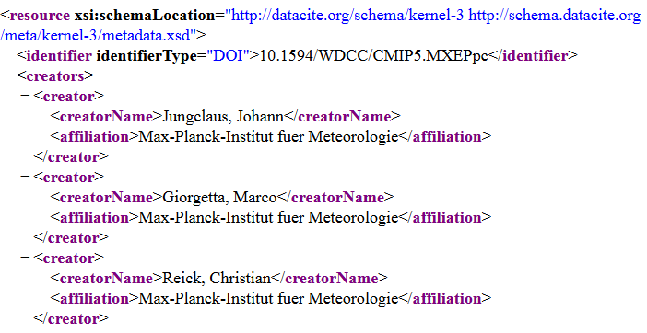
I. Citation: Machine Access (3)
2. Access all available citation entries
ORCID
CrossRef DOI
FundRef
ISNI
DataCite DOI
Project or external catalogues Harvest Citation Information
DataCite MD format
OAI/PMH
OAI/PMH
CMIP6 Citation Data
Register DOI and
Citation Information
doi:10.1002/jame.20038

Slide 15
II. IPCC DDC: Workflow Overview
Provide Citation Information
Update Citation Information
Citation Information fixed
DataCite DOI Registration
ESGF and CMIP data pool (CDP)
Long-Term Data Archival
IPCC DDC Reference Data Archive
ESGF and CDP
Answer CMIP6 Call for Mod. Centers
Model Runs and CMOR
Additional and Corrected Dataset Versions
CMIP6 – dynamic data
AR6 – stable data
CMIP6 Call to Mod. Centers
IPCC WGI AR6 Submission Deadline
Time

Slide 16
II. IPCC DDC: Overview
IPCC DDC (IPCC Data Distribution Centre):
“The DDC is designed primarily for climate change researchers, but materials contained on the site may also be of interest to educators, governmental and non-governmental organisations, and the general public.” (source: http://ipcc-data.org)
IPCC DDC Organization:
DDC is overseen by IPCC TGICA (Task Group on Data and Scenario Support for Impact and Climate Analysis)
DDC is jointly managed by the BADC (British Atmospheric Data Centre), the WDC Climate at DKRZ, and the CIESIN (Center for Int. Earth Science Information Network)

Slide 17
II. IPCC DDC at WDCC / DKRZ
World Data Center for Climate
Long-Term Archive for Climate Data
1992: Long-term archive for climate data
2003: regular member of the ICSU World Data System, 2011 renewed ICSU WDS membership/certification
2010: WDCC moved to Deutsches Klimarechenzentrum
IPCC-DDC at WDCC / DKRZ Reference Archive for Climate Model Output Data
1995: LTA for IPCC climate model data since SAR
2008: parts of FAR added to DDC
2013/14: LTA of IPCC AR5
Notes:
FAR: NCAR comparable role to ETH Zurich in AR5

Slide 18
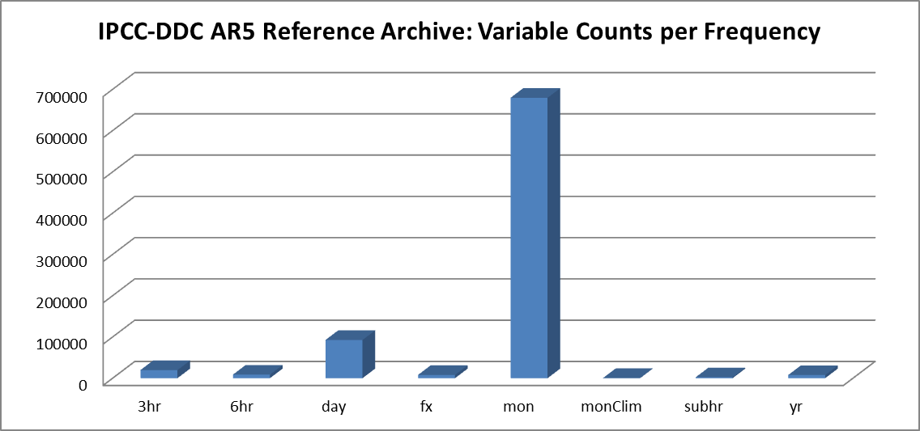
II. IPCC DDC: AR5 Reference Archive (1)
The DDC Reference Archive / The IPCC WG1 Archive
Experiments: | 101 / 78 | different experiments / scenarios
Variables: | 605 / 123 | different variables (628 requested variables)
Size: | 1.6 PByte / 100 TByte | (all AR data: 1.7 PByte)
Models: | 60 / 58 | participating models
Institutes: | 27 / 24 | participating institutes
Simulations: | 1145 / 952 | provided simulations
Variables: | 818795 / 93247 | provided variables

Slide 19
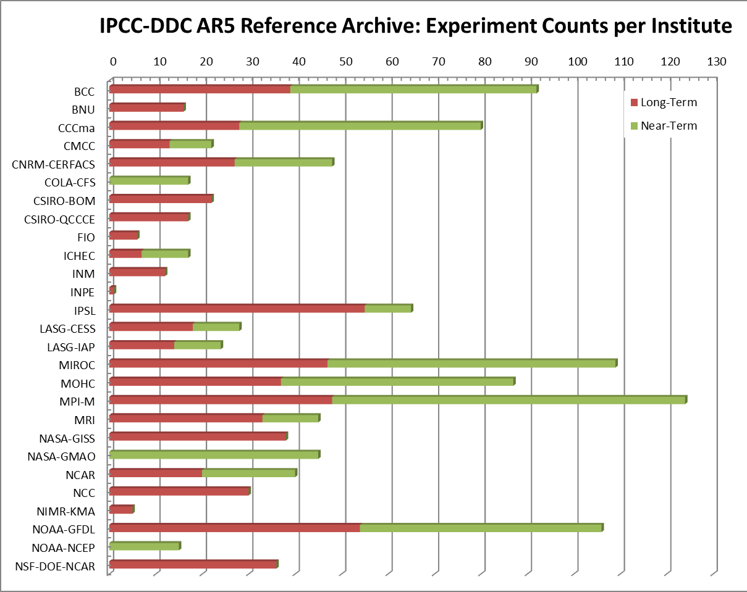
II. IPCC DDC: AR5 Reference Archive (2)

Slide 20
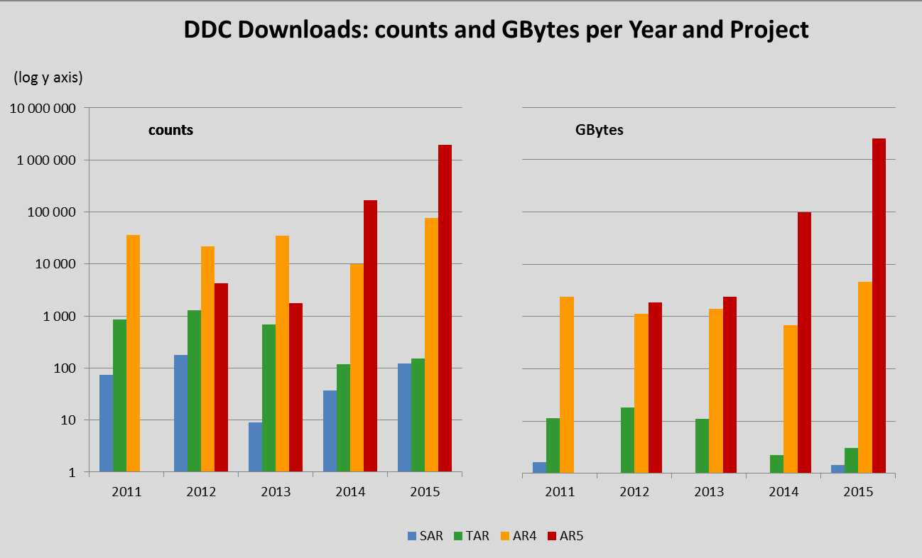
II. IPCC-DDC: Usage (1)
Reference Archive for Climate Model Output Data
1 PByte
1 TByte

Slide 21
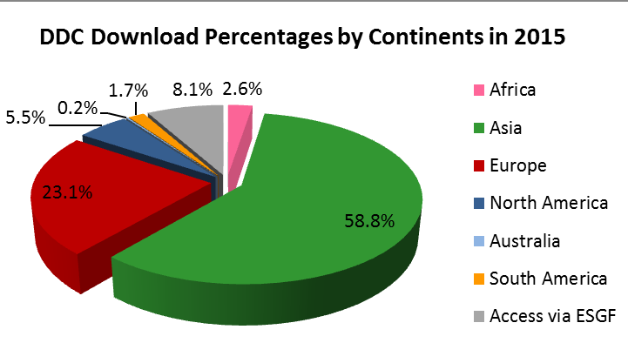
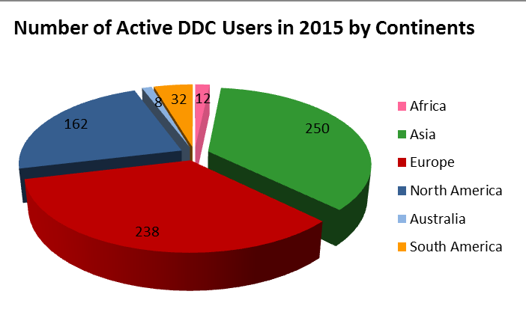
II. IPCC-DDC: Usage (2)
Reference Archive for Climate Model Output Data
702 Active DDC Users in 2015:
42% located in developing and economy-in-transition countries (Africa, Asia, South America)
15 users requested regional data on storage media
Download Counts per Continent in 2015:
> 2 mio. file downloads
average download count per user = 2 800
Asian and African users were the most active with average download numbers per user of 5 000 and 4 600.

Slide 22
II. IPCC-AR6 DDC at WDCC / DKRZ
IPCC-AR6 DDC at WDCC/DKRZ:
CMIP6 Data Repository to support IPCC AR6 WGI (WGII/III)
IPCC-AR6 Reference Climate Data Archive

Slide 23
II. IPCC DDC: 1. CMIP6 Data Repository
1. CMIP6 Data Repository for IPCC AR6 WGs:
New activity of IPCC DDC at DKRZ for AR6
Strengthened support the internal work of the IPCC AR6 WGs
Similar to the CMIP5 Data Repository hosted at the ETH Zurich / IPCC AR5 WGI TSU
→ synergy with DKRZ’s CMIP Data Pool (CDP) (see presentation of Stephan Kindermann) → under discussion within IPCC:
01/2016: IPCC Expert Meeting on the future of TGICA
08/2016: Future Earth-PROVIA-IPCC workshop (August 2016)

Slide 24
II. IPCC DDC: 2. AR6 Reference Data Archive
2. IPCC-AR6 Reference Data Archive
Existing activity of IPCC DDC at DKRZ since IPCC SAR
Long-term archive for data underlying AR6 WGI for interdisciplinary long-term usage
Data enriched with information on experiment, simulation, annotation, citation, contacts, etc. and add Atlas data
Data citable with DataCite DOIs
Snapshot of CMIP6 data at IPCC AR6 WGI submission deadline
Special support for developing and economy-in-transition countries in shipping data subsets for selected domains on storage media (AR4/AR5/AR6)
http://ipcc-data.org http://ipcc.wdc-climate.de

Slide 25
II. IPCC DDC: LTA Workflow
Quality
Errata
Citation
Citation Information
Quality Results
Errata Results
Citation Info
CIM Docs
ES- DOC
Registration
Node
2a
Index Node
Portal
Data
Metadata Ingest incl. External Information
Data Node
4
1
2b
Meta- data
Node
DataCite DOI / Citation Information
+ other catalogs
CMIP Data Pool (CDP)
QA process
Data
Data Node
Data Replication
Data Archival
LTA Data
3
…
Project Data Repositories
DKRZ
WDCC:
Long-term Archive
Replicate
LTA
DataCite DOI
Share DOI
1
2
3
Based on: Stockhause, Martina (2014). Long-term archiving workflow in CMIP5 - a first review.
ISENES2 Workshop, Hamburg, 03.-05.06.2014. Zenodo. doi:10.5281/zenodo.29104
4

Slide 26
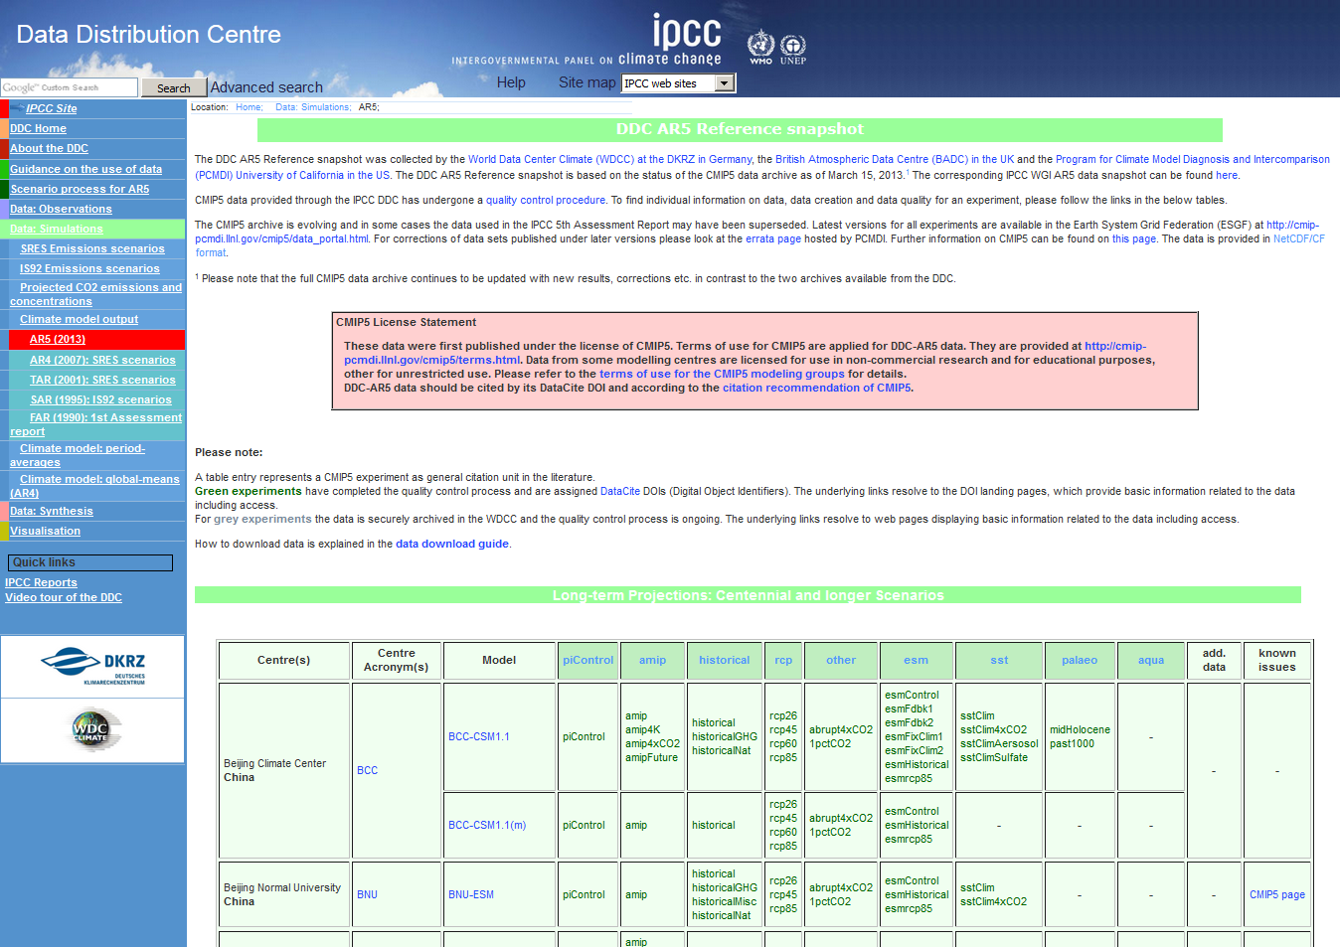
Data Citation CMIP6: http://cmip6cite.wdc-climate.de
IPCC DDC: http://ipcc-data.org
DDC at DKRZ: http://ipcc.wdc-climate.de
M. Stockhause, F. Toussaint, M. Lautenschlager (2015): CMIP6 Data Citation and LTA. WIP white paper. Zenodo. doi:10.5281/zenodo.35178.

Slide 27
II. IPCC DDC: LTA Motivation for AR6
Reduce number of interfaces to handle
Stable and reliable technical interfaces providing the same information over time
No mapping of DRS components
CMIP6 infrastructure provides all necessary information for LTA / IPCC DDC
Shift responsibility for relations to external information from LTA to providers
Compared to AR5: simpler and automatable LTA with reallocated responsibilities

